Slide 1
Can you break the code?
Snczx’r kdrrnm hr zants:
Dmbqxoshnm zmc Cdbqxoshnm

Slide 2
Can you break the code?
Today’s lesson is about:
Encryption and Decryption

Slide 3
WALT
Understand the basics of Cryptography
Write simple cipher text
Understand the importance of Cryptography in computer history
Key Words: encryption, decryption, key, cipher text, cryptography, public key, private, cipher wheel

Slide 4
Cryptography
Cryptography is derived from the Greek word ‘kryptos’ which means hidden or secret
Cryptography is the art of protecting information by transforming it (encrypting it) into an unreadable format, called cipher text.

Slide 5
Encryption
Encryption is the process of encoding messages (or information) in such a way that third parties (called adversaries) cannot read them
It is used to send information securely across networks such as the Internet

Slide 6
Websites are encrypted to protect personal data being sent over the Internet

Slide 7
How Encryption Works
Your Public Key
The (Encryption) KEY is used to make the information unreadable (like a secret code)
Your Private Key
Your Public Key
You
Sender
Message
Hello how are you
The Public Encryption key is sent from YOU to the SENDER

Slide 8
How Encryption Works
Your Public Key
Your Private Key
Your Public Key
You
Sender
Encrypted!
$%%$%
%&87$
Message
Hello how are you
The Message is Encrypted using the Public Key

Slide 9
How Encryption Works
Your Public Key
Your Private Key
Your Public Key
You
Sender
Encrypted!
$%%$%
%&87$
…and sent back to you

Slide 10
How Encryption Works
Your Public Key
Your Private Key
Your Public Key
You
Sender
Encrypted!
$%%$%
%&87$
You DECRYPT the message using your Private key

Slide 11
How Encryption Works
Your Public Key
Your Public Key
Your Private Key
You
Sender
Encrypted!
$%%$%
%&87$
Message
Hello how are you
You DECRYPT the message using your Private key

Slide 12
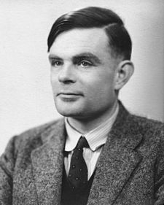
Encryption
Encryption is the process of encoding messages (or information) in such a way that third parties (called adversaries) cannot read them
Video

Slide 13
Caesar Ciphers
Named named after Julius Caesar who used them to protect messages he sent to his army officers.

Slide 14
Cipher Wheel
Key = 1
Plain Text (Outer wheel) | Cipher Text (Inner wheel)
Y | Z
X | Y
W | X
V | W

Slide 15
Cipher Wheel
Key = 5
Plain Text (Outer wheel) | Cipher Text (Inner wheel)
U | Z
T | Y
S | X
R | W

Slide 16
Can you break the code?
Cipher Text
Snczx’r kdrrnm hr zants:
Dmbqxoshnm zmc Cdbqxoshnm
Today’s lesson is about:
Encryption and Decryption
Plain Text
Key = ?

Slide 17
Cipher Wheel
Key = 25
Key = 25
Plain Text (Outer wheel) | Cipher Text (Inner wheel)
T | S
U | T
S | U
R | V

Slide 18
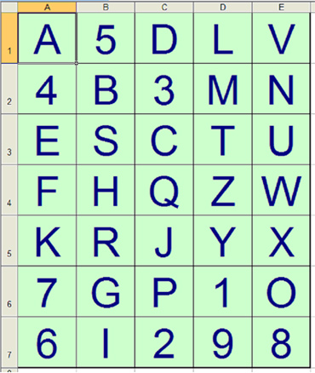
Can you decode this message
D3 B7 D2 A3 D3 E6 B6 E6
D5 A3 A1 B5 D7

