Slide 1
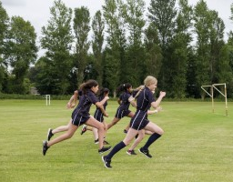
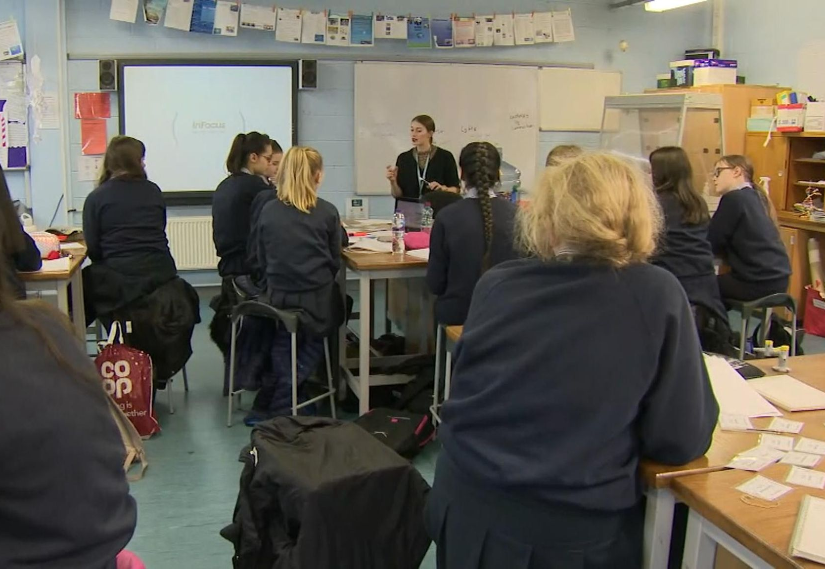
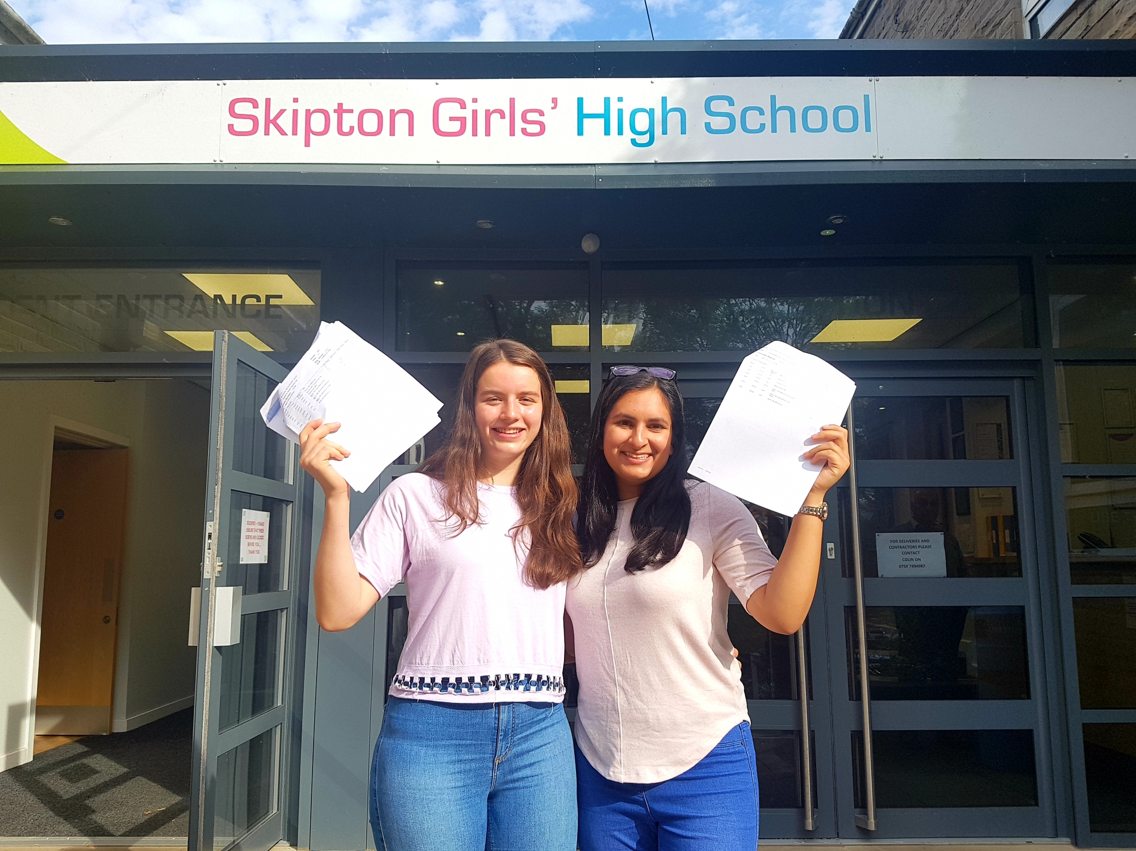
Welcome to Skipton Girls’High School

Slide 2
Student Progress Faculty
Tutor group and House system
School home liaison and support
How to support your child at SGHS
Year 7 residential
SGHS students
Laptop scheme.
Friends of SGHS.

Slide 3
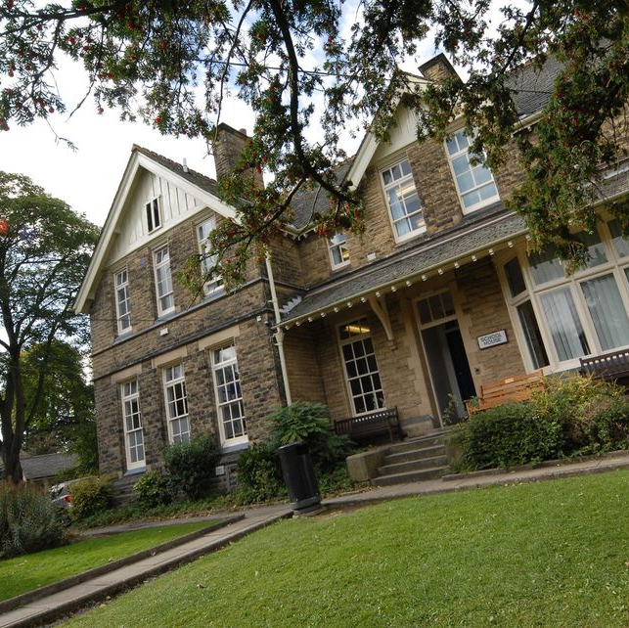
Student Progress Faculty
Mrs Pitt
SENCo – Special Educational Needs Coordinator
Mrs Marchesi - SP Learning Director
Mrs Kendrick - Year 7 & 8
Miss Hogg - Year 9 & 10
Miss Smith - Year 11
Mrs Uren - Year 12 /13

Slide 4
Student Progress Faculty
Fiona McMillan
Deputy Headteacher :
Inclusion
Diversity & Equity
DSL Safeguarding
Jane Marchesi
Learning Director Student Progress
Deputy DSL
SEND Assistant

Slide 5
Social Media & Attendance
Safeguarding

Slide 6
Head of year 7 & 8
Monitor the year group's behaviour, progress in lessons, attendance and punctuality, participation in all aspects of school life, support students academically and pastorally.
Work in partnership with Mrs Kendrick and the Student Progress Team.

Slide 7
Our Teaching Groups
7B
7C
7F
7J

Slide 8
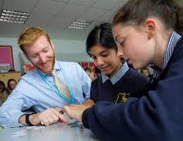
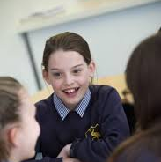
Our Vertical Tutoring System
Students are divided into 4 houses:
Bronte
Curie
Franklin
Johnson
Each House contains 8 or 9 tutor groups
Each tutor group consists of 3 or 4 students from each year group.

Slide 9
Contact between home and school
SIMS in TOUCH is used as a channel of communication with both the personal tutor and subject staff but you can of course use the phone!
Important to contact us as soon as possible if there is an issue, no matter how big or small, whether it is something you just want us to know, or something that needs dealing with.
You will get to know your child’s Personal Tutor and will have the opportunity to meet them during the first term.

Slide 10
Thursday 12th September – meeting with parents in school .
Monday 30th September ‘Meet the tutor’ event.
Each student will receive 2 reports during Year 7. These outline commitment to learning and attainment feedback.
Year 7 parents evening - summer term.
Parents/staff can use SIMS in TOUCH throughout the year for contact at any other time.
Please feel free to contact staff about any issue at any time – they will be happy to help.

Slide 11
How can I help my child?
Agree a routine for ensuring they leave on time for the bus/train and go to bed at a reasonable hour.
Make sure they know how to get home if they miss the bus/train.
Label ALL belongings with their name, PE kit.
Check that their bag is packed with the right equipment before bedtime.
Buy them a watch, we don’t have bells.
Help them organise space at home for books to be stored and homework to be completed.
Check that they are up to date
Encourage them to mix with other students, expect changes in friendship groups, join clubs to help this.
But most of all encourage them to get involved, to push themselves and to enjoy every minute of their time at Skipton Girls’.

Slide 12
Year 7 Residential
w/c 4th November
Carlton Lodge, Outdoor Education Centre
https://www.carltonlodge.org.uk/our-activities
Range of outdoor activities
Teambuilding exercises and opportunities to work with others
Learn new skills
Bonding exercises with new peers
Create new friendships

Slide 13
Year 7 Residential
Mon, Tues – Wed lunch 2 groups
Wed lunch – Friday afternoon 2 groups
Cost around £185 (will not be more than £200)
2 nights overnight stay,
meals provided,
transport to and from Carlton Lodge
activities whilst there and any specialist equipment.
Payment details will become available on parent pay from September – but advance notice for planning ahead.

Slide 14
Life as a SGHS student
Lucy – Head Girl
Zoya – Deputy Head Girl
Lia – Deputy Head Girl
Lucy – Deputy Head Girl
Year 7 student executive team
Tehmida
Olive

Slide 15
Laptops

Slide 16
Laptop Scheme
All students buy into the school laptop scheme
£17 per month for 3 years
Parent pay details and laptop scheme will be emailed by the ICT as a follow up to tonight's meeting.
Proposed meeting for Parents and Carers 12th September to demonstrate Firefly access and use to parents.
Any further questions regarding the laptop scheme: lofthouser@sghs.org.uk

Slide 17
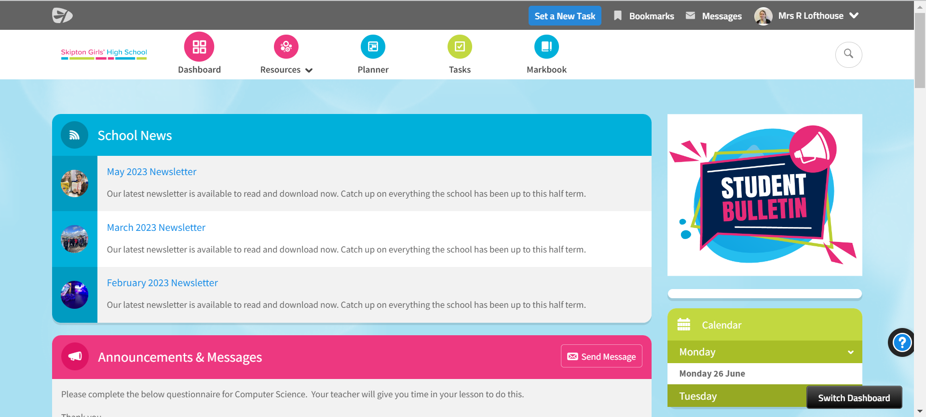

Slide 19
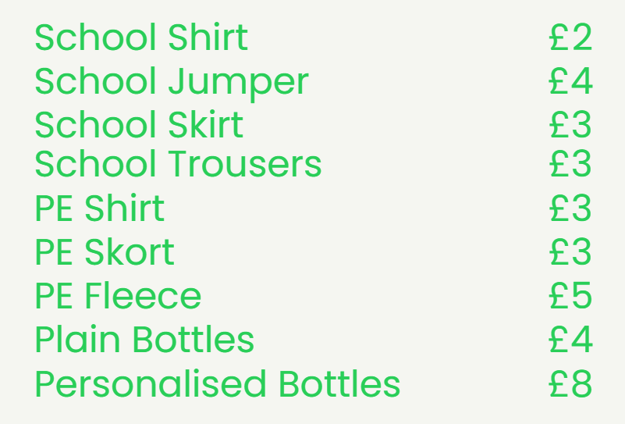
Sustainability

Slide 20
Friends of SGHS http://www.pta_events.co.uk/friendsofsghs

Slide 21
Please remember:
https://sghs.fireflycloud.net/year-6---7-transition/year-7-information-for-parents-and-carers
The day to day information is in here:
School day
Uniform
School term dates
Transport
Mobile phones

Slide 22
Contacts:
transition@sghs.org.uk
winterm@sghs.org.uk
kendrickp@sghs.org.uk
studentservices@sghs.org.uk
studentprogress@sghs.org.uk
Website links:
Firefly link to year 6 transition page
https://sghs.fireflycloud.net/year-6---7-transition
https://www.sghs.org.uk/
https://www.carltonlodge.org.uk/our-activities
send@sghs.org.uk

