Slide 2
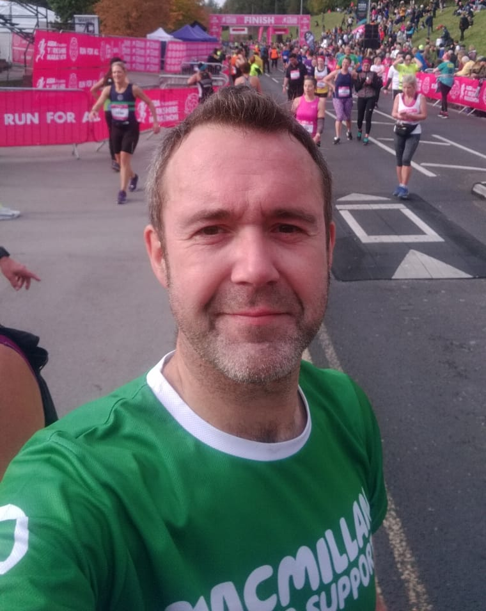
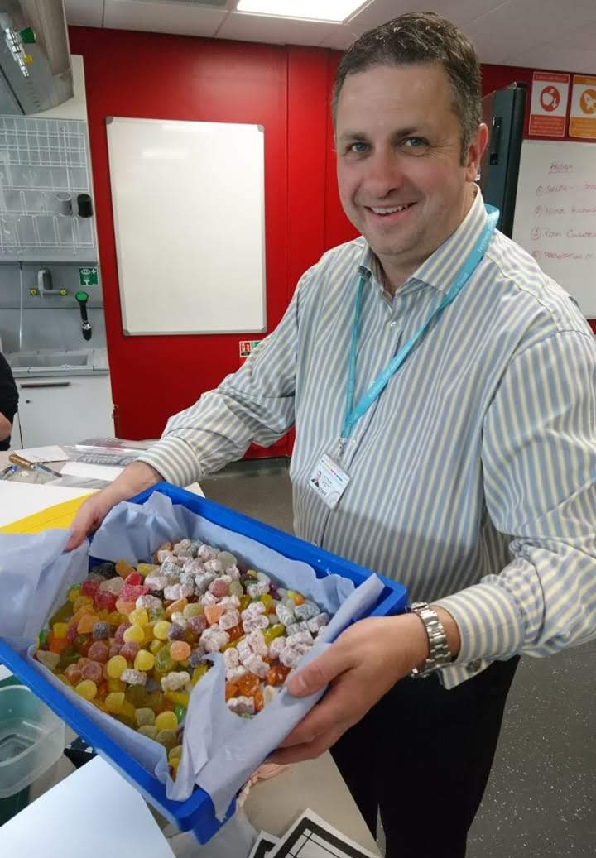
Meet the Design Engineering team……..
Fun Facts:
Worked in the steel industry as an engineer before becoming a teacher
Absolutely loves to cook, bake bread and build Lego!
Absolutely LOVE Candyfloss!!
Mr Green
Fun Facts:
Completed the Yorkshire Marathon last year and raised £800 for Macmillan Cancer Support!
Was an Electronics Engineer before becoming a teacher
Has a passion for cycling and music…….loves Lego too!!
Mr Braden

Slide 3
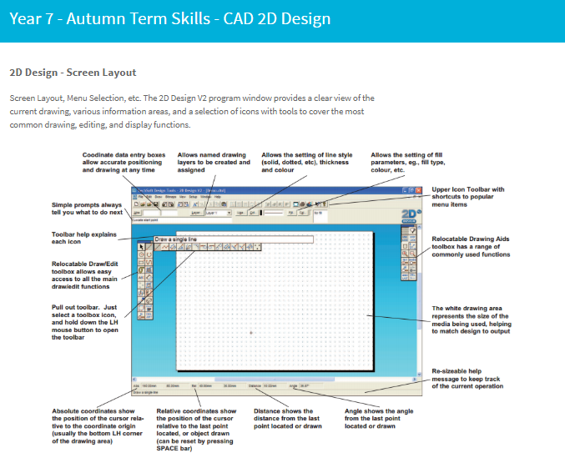
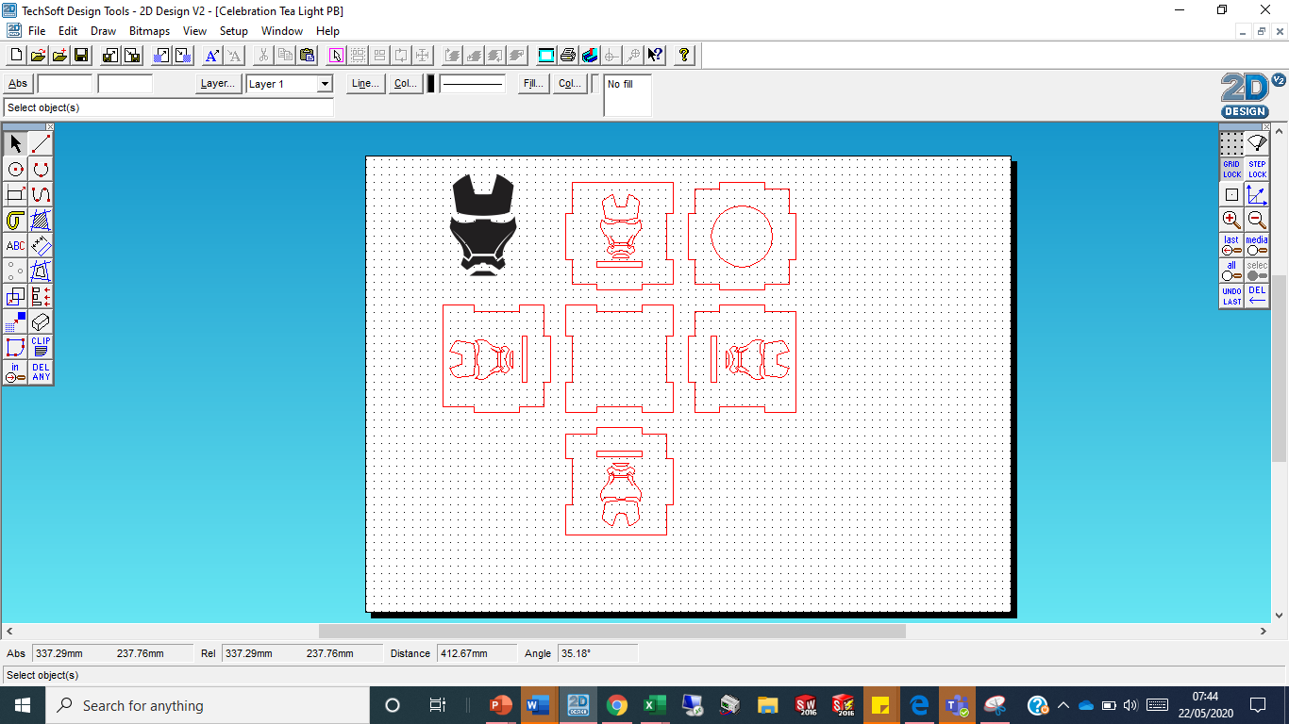
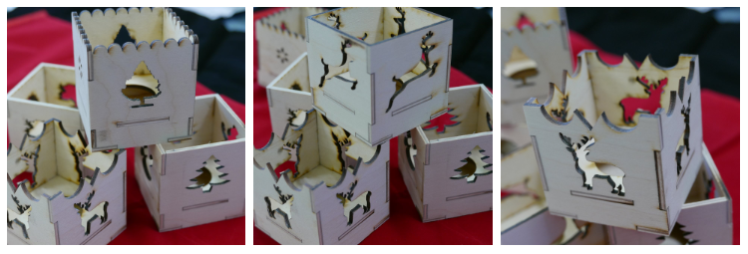
Year 7 Project - Celebration Tea Light Holder
Project Focus: Learning how to use Computer Aided Design (CAD) to create a project!

Slide 4
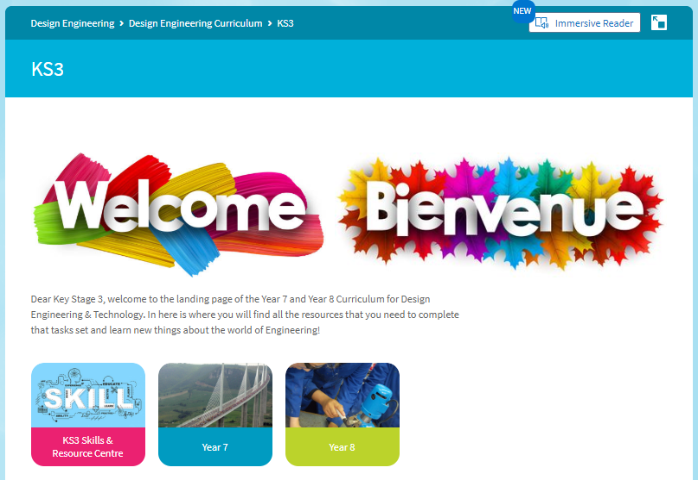
Design Engineering VLE…..
To help and support your learning………

Slide 5
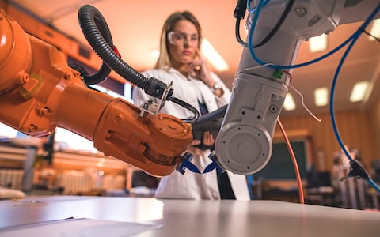
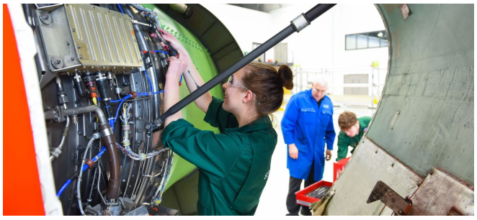
Why is Engineering important?
Engineering is the process of designing the human-made world.
Engineers use knowledge and creativity to find solutions to society’s problems.
Engineers always look for ways to improve things.

Slide 6
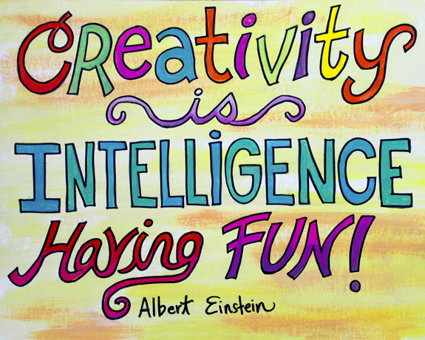
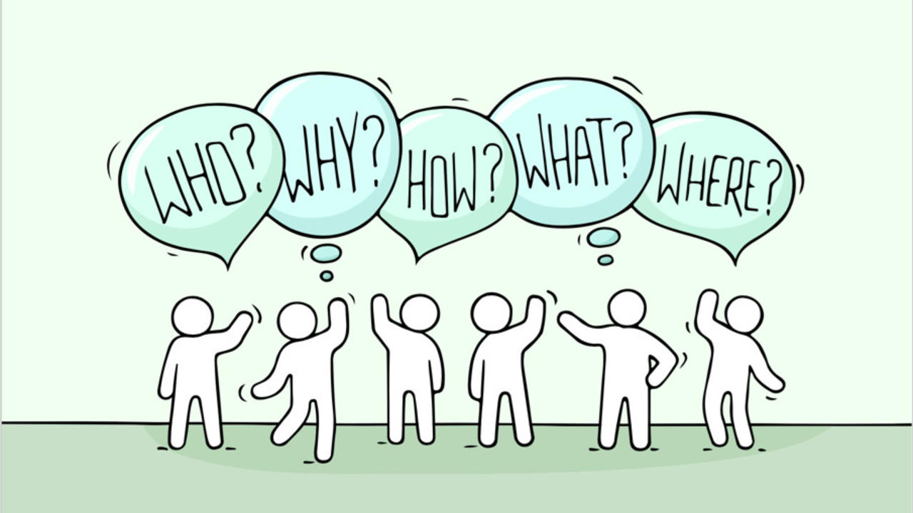
Remember to….
….we are really looking forward to meeting you in September!!!

