Slide 1
Race
This is the category which applies to your appearance.
Do you want to be a good old human, someone smaller/bigger/scalier?

Slide 2
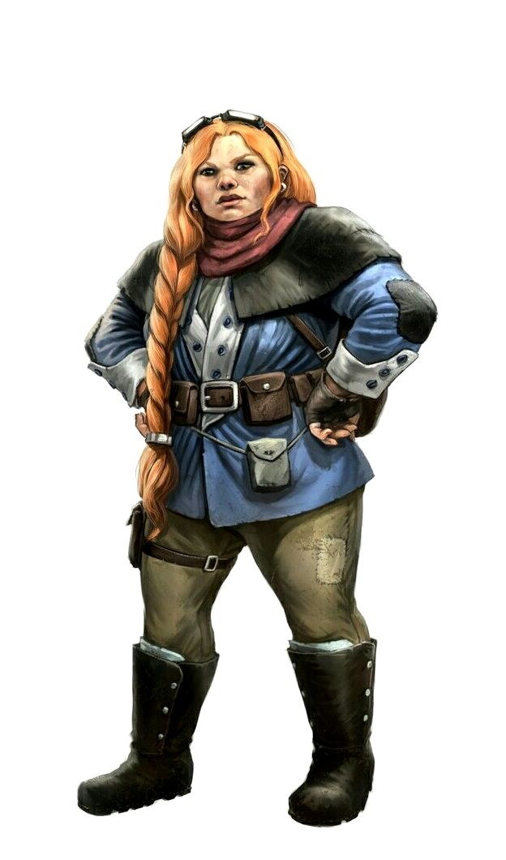
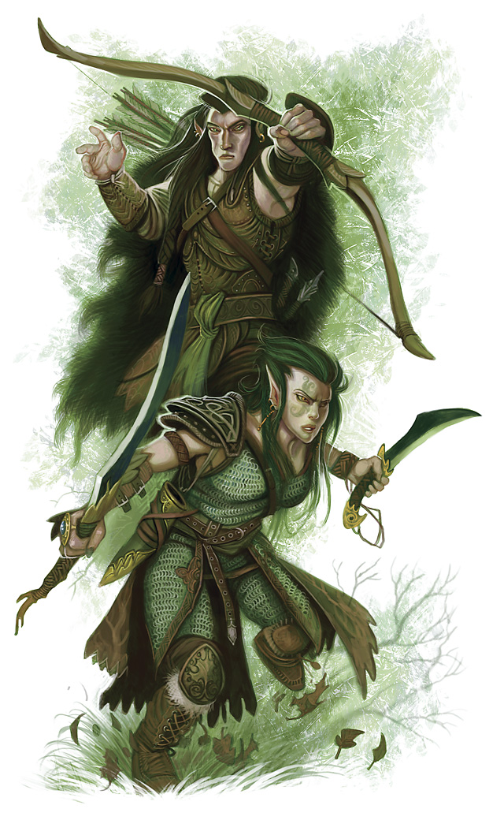
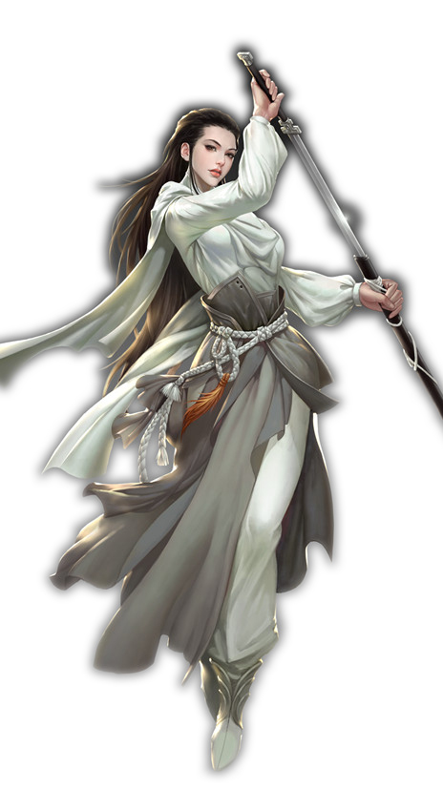
Humanoids
Dwarves – a rich historied race with halls of grandeur carved into mountains, this stout and short race are hard workers with bold personalities to match. They love family but seek honour and glory.
Elves – otherworldly grace is possessed by elves; with an ethereal beauty, elves often live in forests. They love nature, magic, art, music, poetry and the good things in the world.
Humans – the youngers of the common races & most diverse, humans are exactly what you would expect. What drives them is innovation, achievement and discovery.

Slide 3
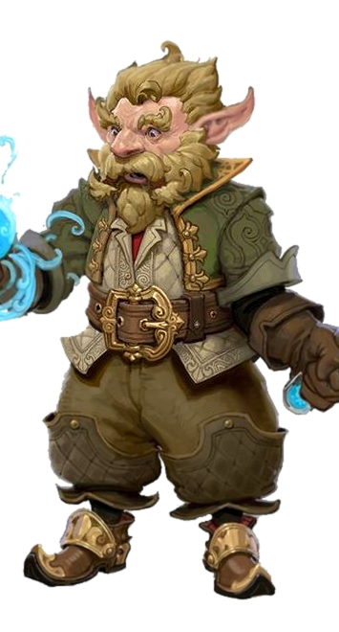
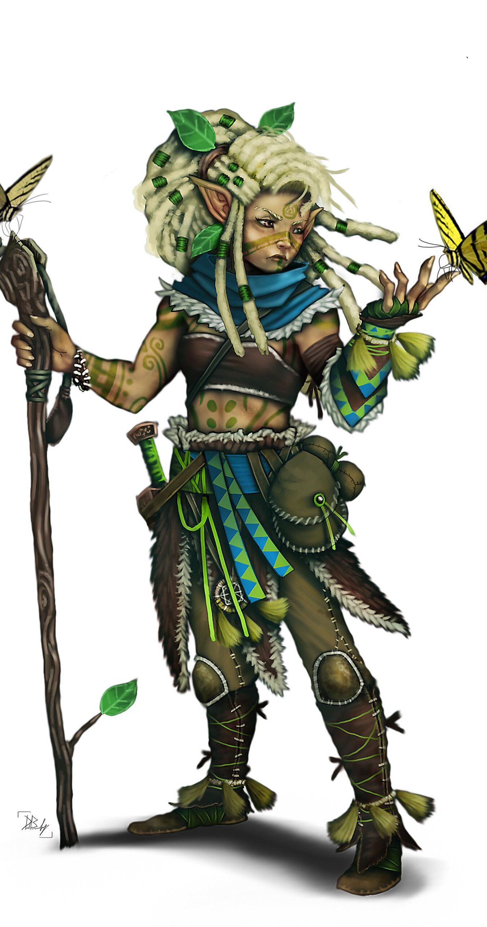
Small Folk
Gnomes – the most energetic of the race, heralding from cramped neighbourhoods and large families. Gnomes take delight in life, enjoying invention, exploration, investigation, creation and play.
Halflings – known as a peaceful people, who cherish the comforts of home, Halflings live in agricultural communities or in nomadic bands that travel.

Slide 4
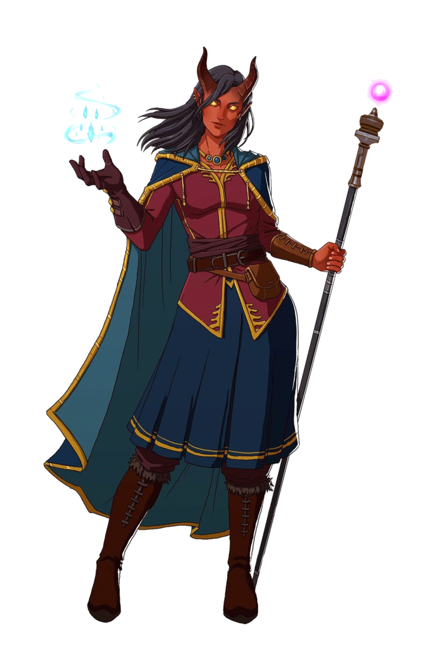
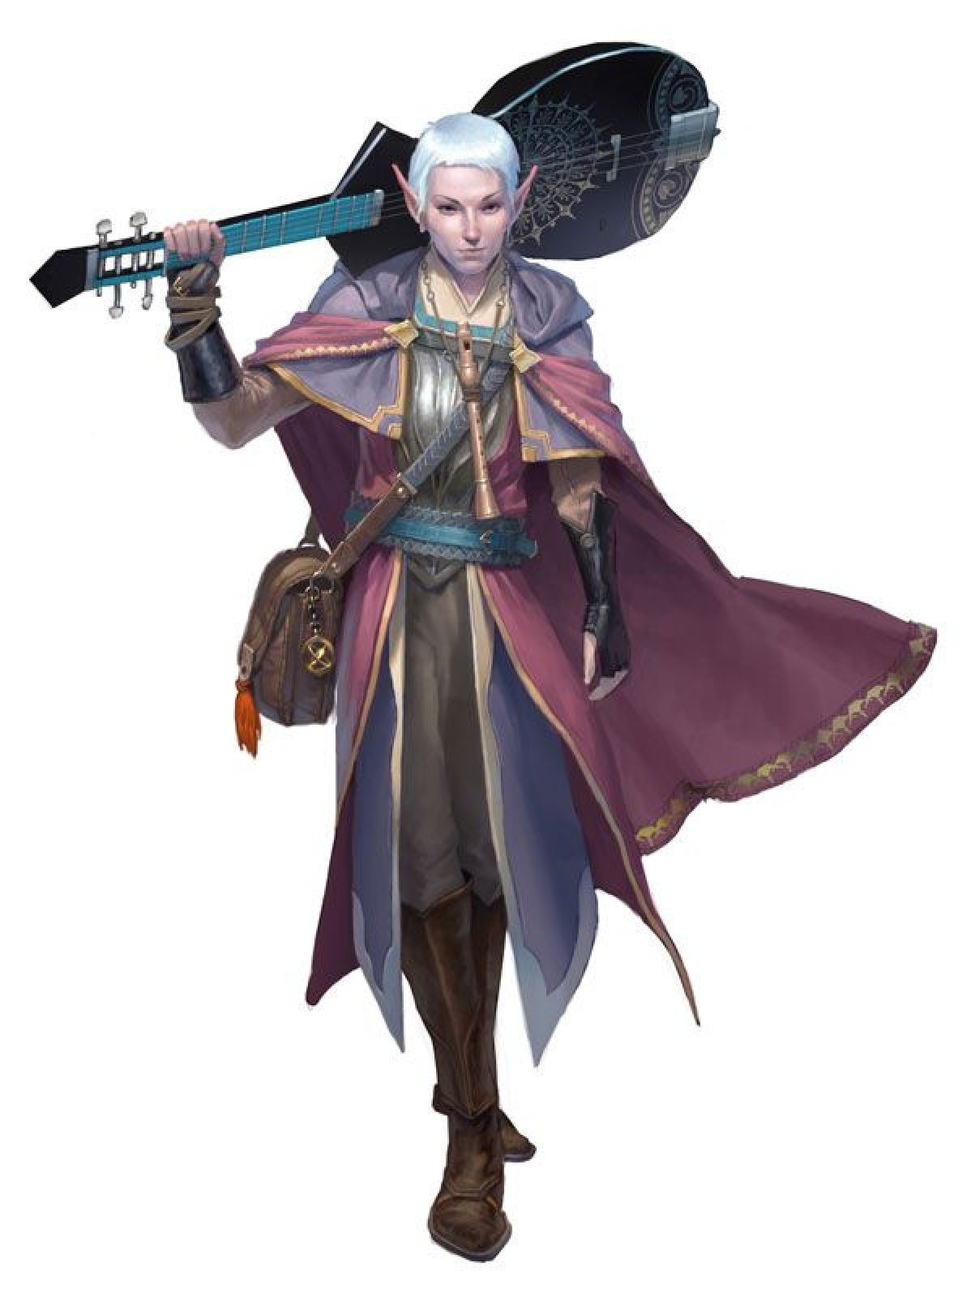
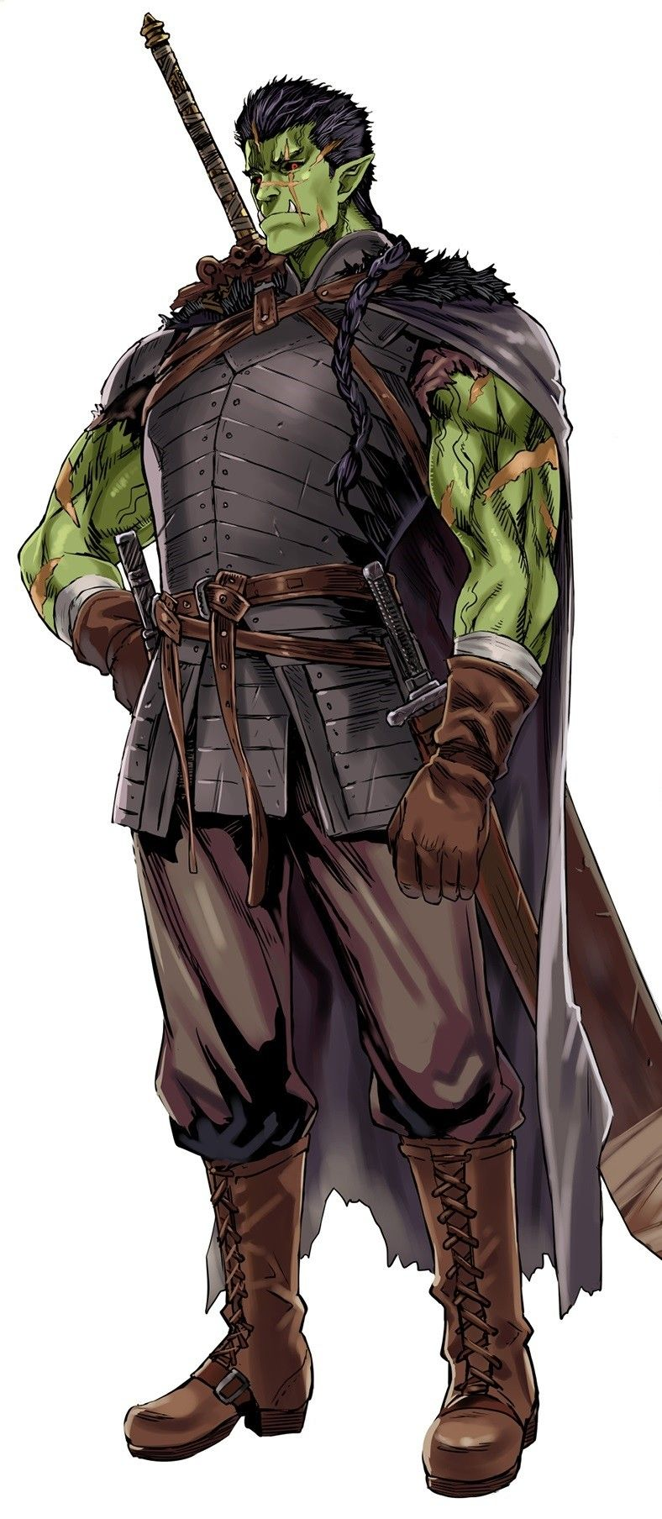
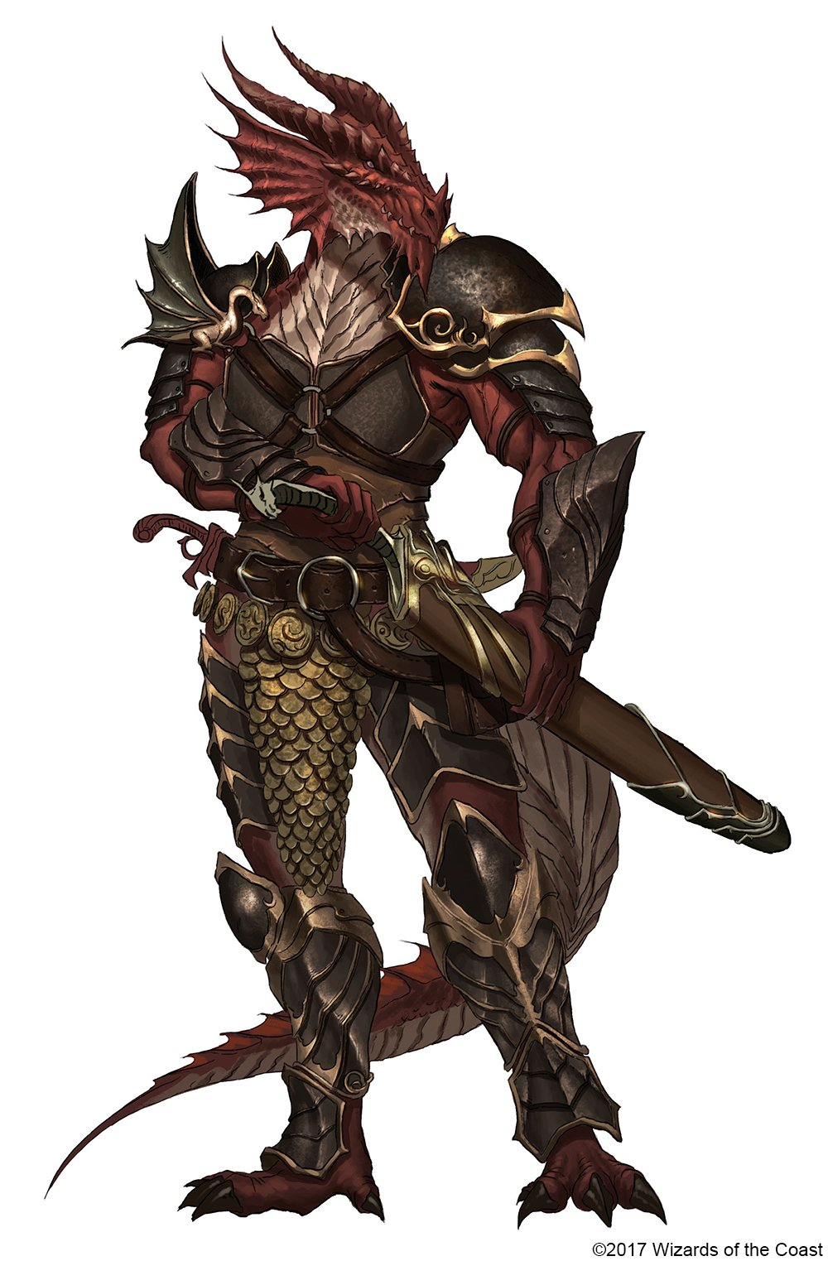
Misfits
Tiefling – suffering hatred, mistrust or fear, Tielfings hail from a demonic bloodline. Their appearance and nature are a result of ancient sin, many can submit to the darkness of their blood whereas others may seek to reject it.
Half Elves – with qualities of humans and elves, these “half breeds” find themselves between worlds. They often choose a life of solitude or join with misfits and outcasts alike for adventure.
Half Orcs – another mixture of humans, Half Orcs are often feared or rejected. Many venture into a world of hatred with a desire to prove their worth by achieving mighty deeds.
Dragonborn – a humanoid dragon race, hatched from eggs crafted by draconic gods or dragons themselves. They make great warriors but often live on the fringes of society.

Slide 5
https://www.dndbeyond.com/sources/basic-rules/races Find out more about the race which appeals to you most.

Slide 6
Class
This is the category which applies to your abilities.
Do you want to be sneaky, a powerful magician or a skilled fighter?

Slide 7
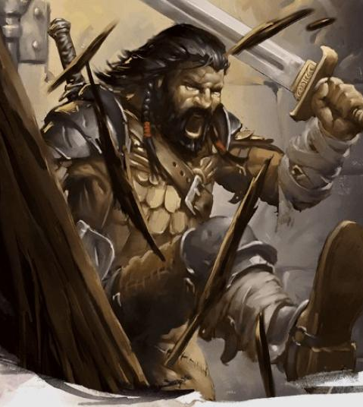
Troops (*magical)
Barbarian – fierce warriors with a primitive background, who rage during battle making them a formidable advisory.
Fighter – a master of combat, skilled with a variety of weapons and armour.
Ranger* – a combatant with marital prowess and a small amount of nature magic to battle threats on the edges of civilization.
Monk – martial artists, who harness the power of their body with physical and spiritual perfection.
Paladin* - a holy warrior, bound to a sacred oath.
Rogue – scoundrels who use stealth and trickery to overcome obstacles and enemies.

Slide 8
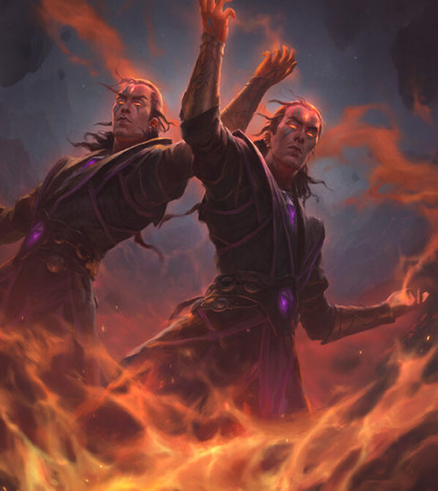
Magicians
Cleric – a priestly champion who wields diving magic in service of a higher power.
Wizard – scholarly magic-user capable of manipulating the structures of reality.
Bard* – an inspiring musician who power echoes the music of creation.
Sorcerer – spellcaster who draws on inherent magic from a personal gift or bloodline.
Druid – a shapeshifter and wielder of the powers of nature: either moonlight, plant growth, fire or lightening.
Warlock - a wielder of magics that is comes from a bargain made with an other-worldly entity.

Slide 9
https://www.dndbeyond.com/sources/basic-rules/classes Find out more about the class which interested you the most.

