Slide 1
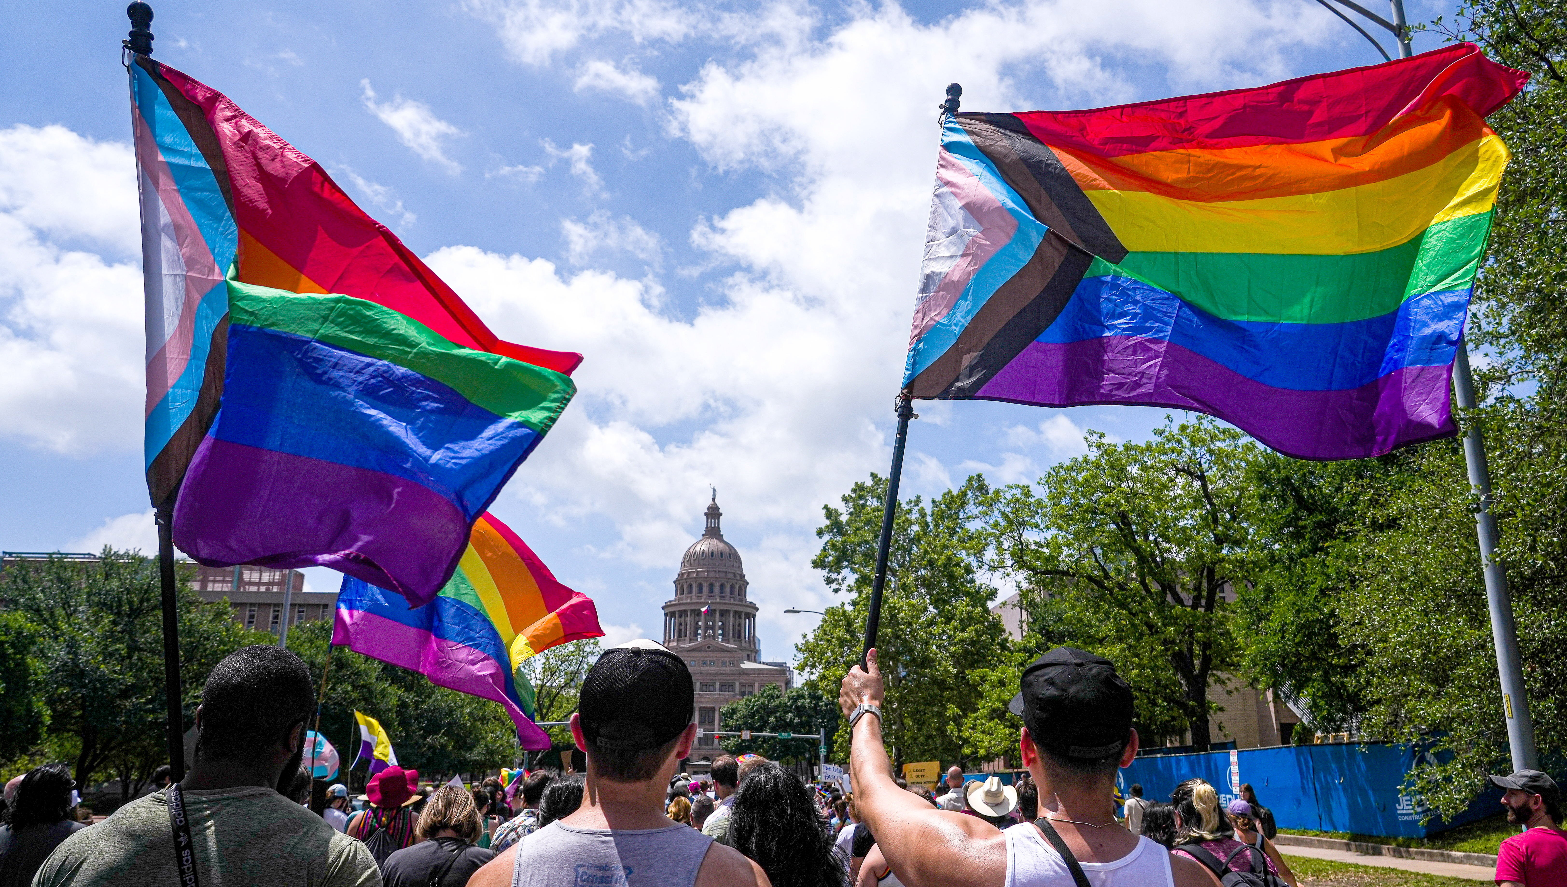
LGBTQIA+ identities
And their flags

Slide 2
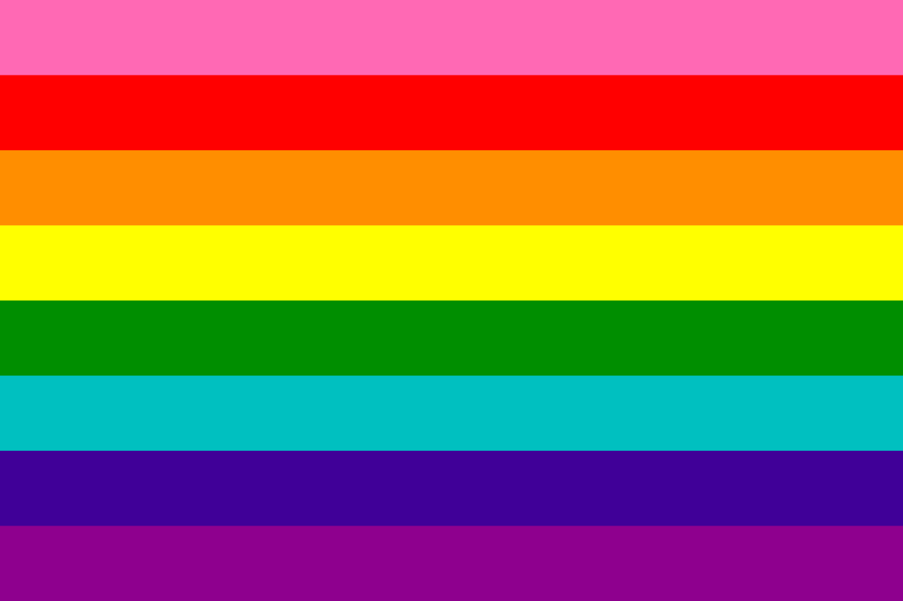
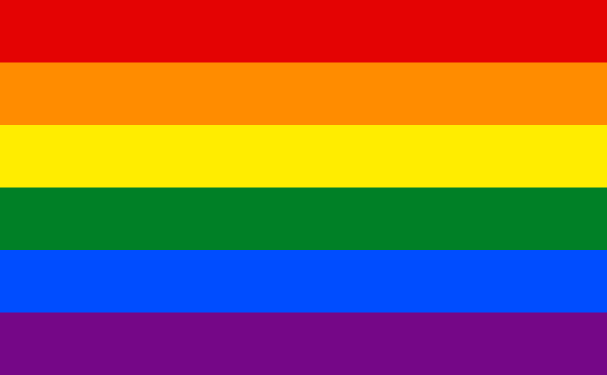
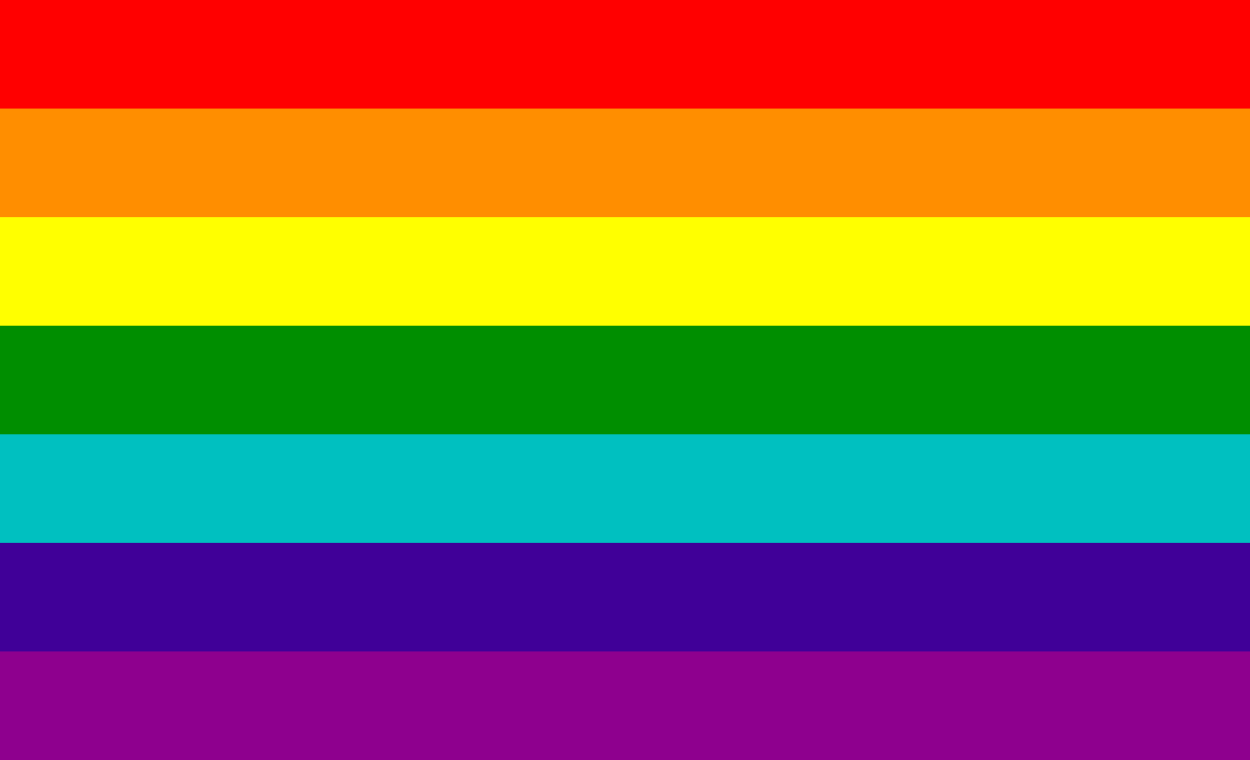
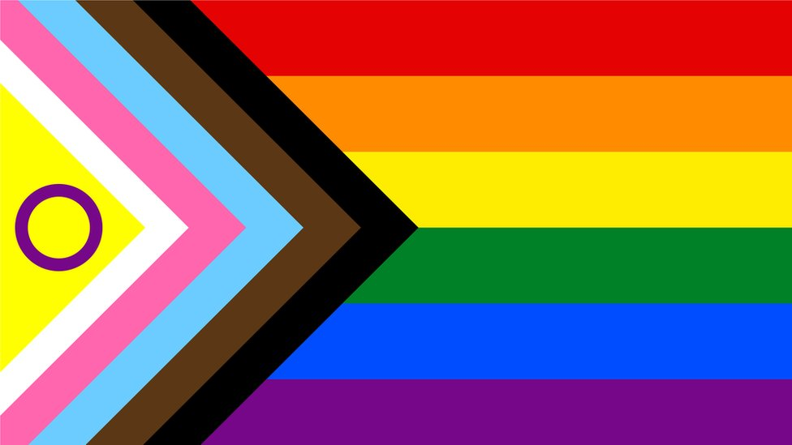
History of the pride flag
1977
Original 8 stripe pride flag created by Gilbert Baker and Lynn Segerblom.
1978
The pink was removed after the Paramount flag company dropped it due to pink fabric not being readily available.
1979
Later the blue and turquoise stripes were combined into just one to give it an even number of stripes for the 1979 San Fransisco Gay Freedom Day Parade.
2017
Black and brown stripes were added for Philadelphia Pride in 2017 to represent people of colour and show support for the racial discrimination they experienced on the gay scene.
2018
3 more stripes were added for Seattle pride adding the colours of the trans flag as well as the two added for POC in the Philadelphia pride flag.
2021
Valentino Vecchietti created the Intersex-Inclusive Progress Pride Flag which has the yellow chevron with a purple circle to represent intersex people, blue, pink and white chevrons to represent trans people and the brown and black chevrons to represent POCs. The black chevron also represents the affect AIDs had on the LGBTQ community

Slide 3
Quiz time !!
How many of these more commonly known identities can you name

Slide 4
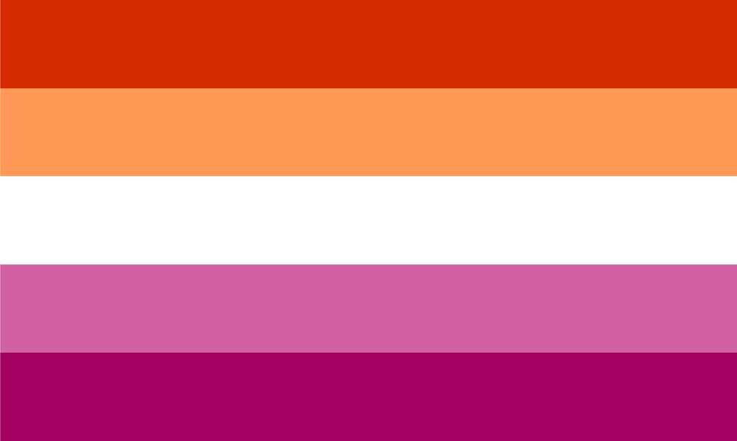
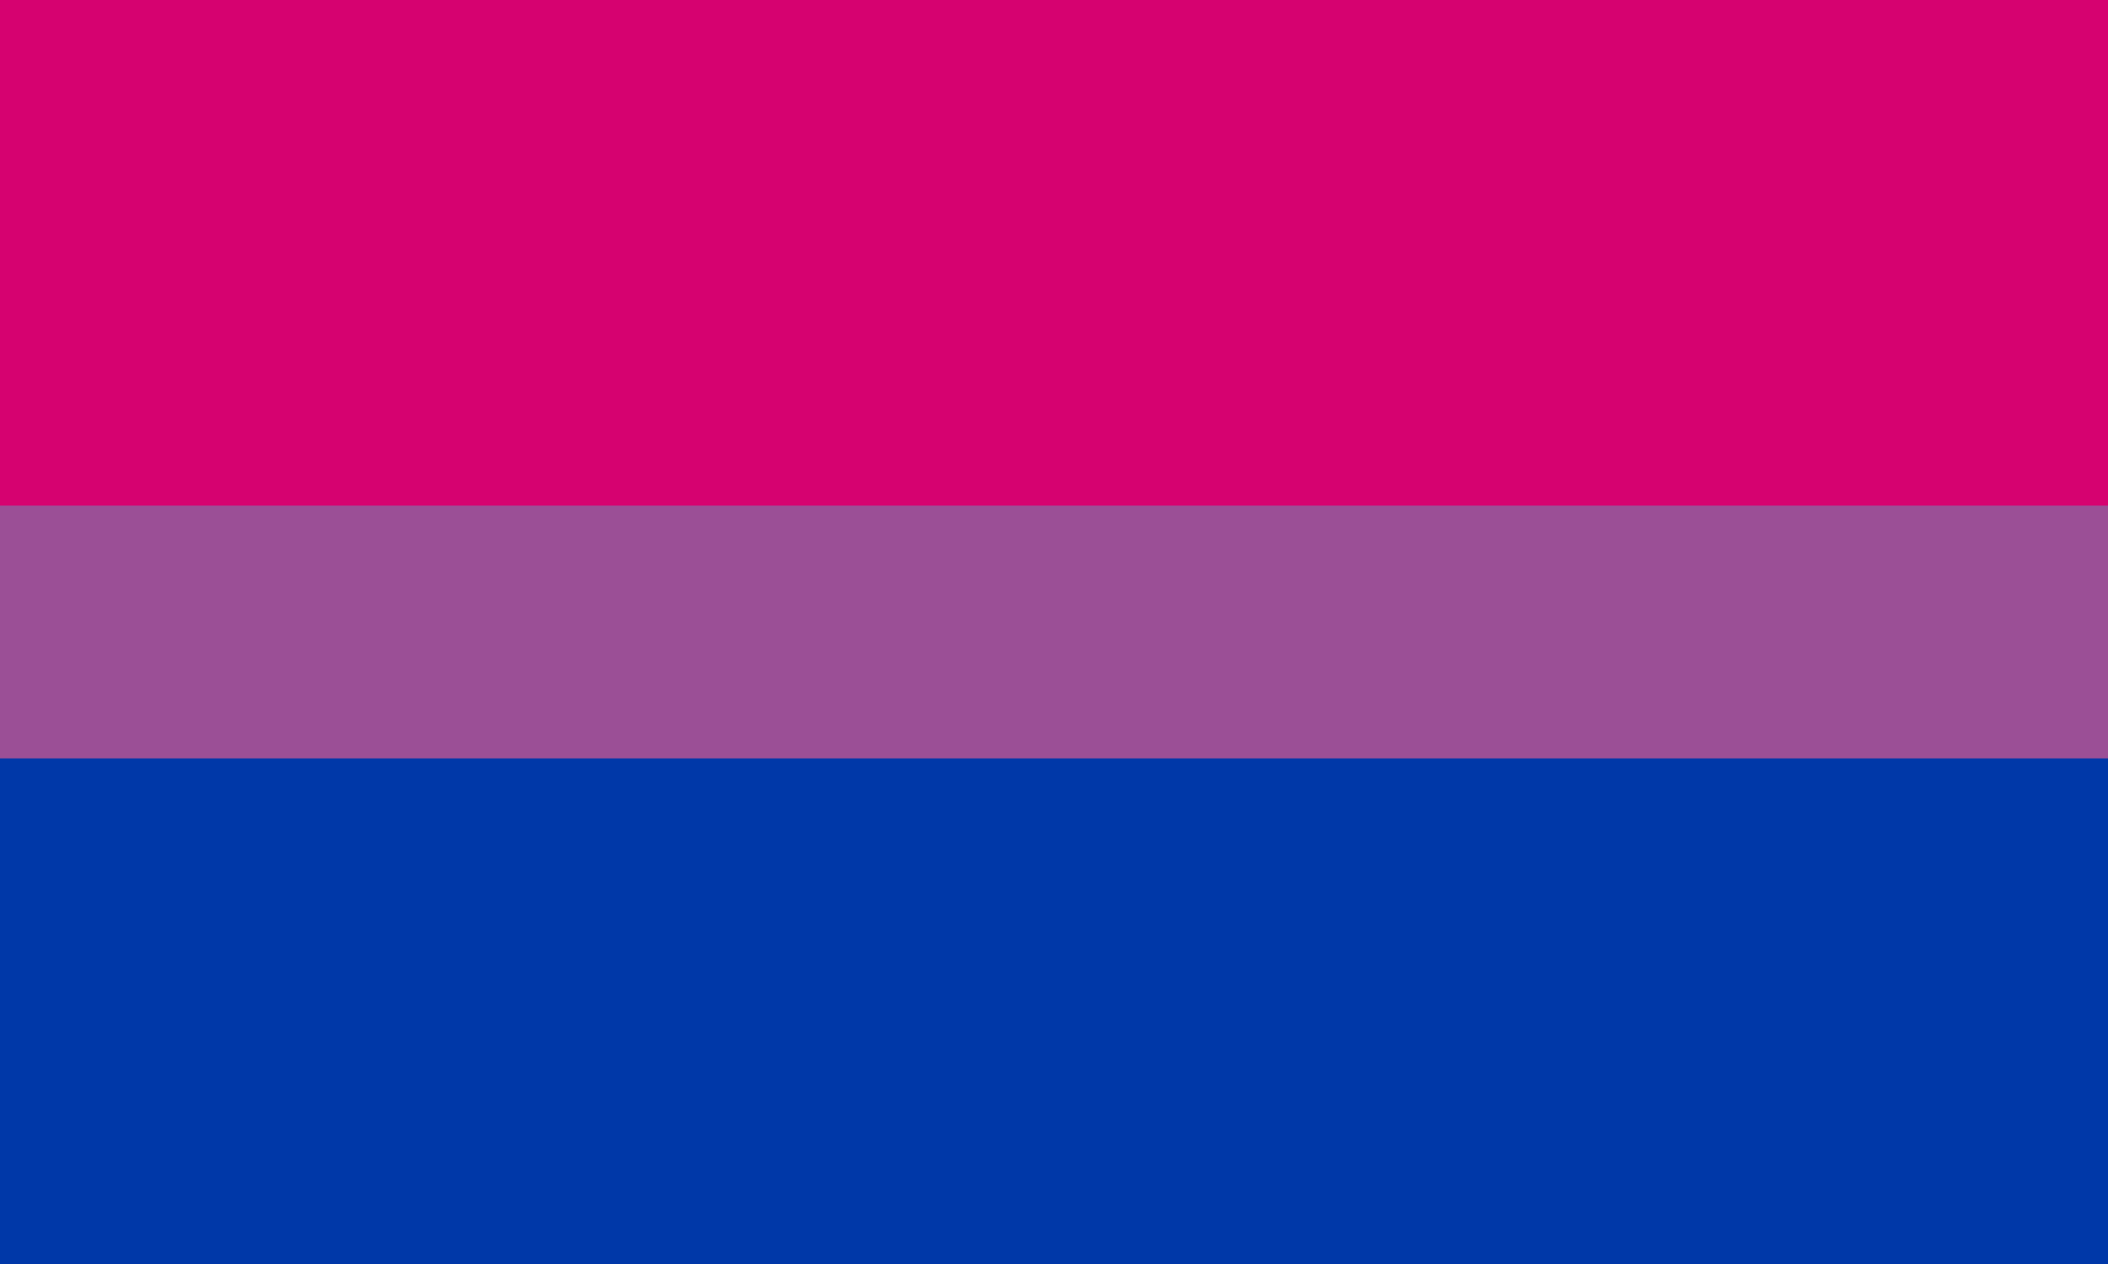
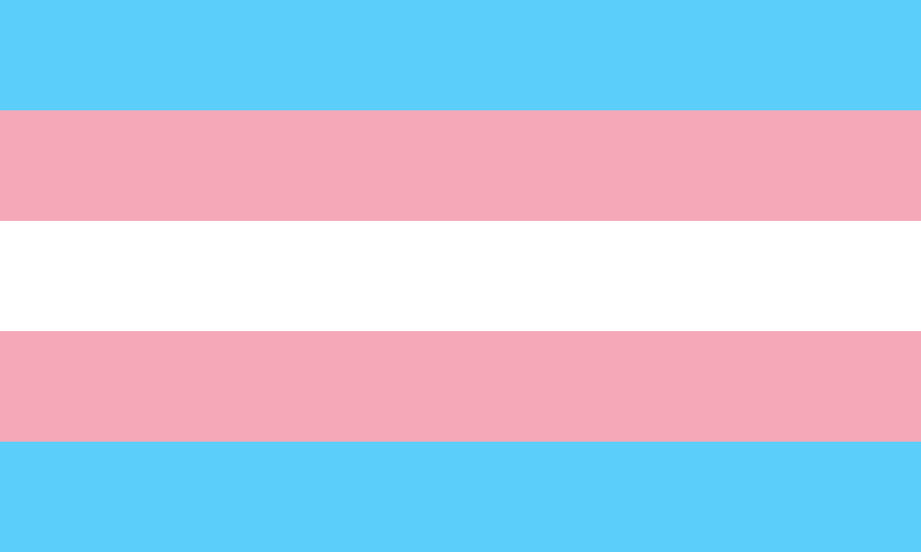
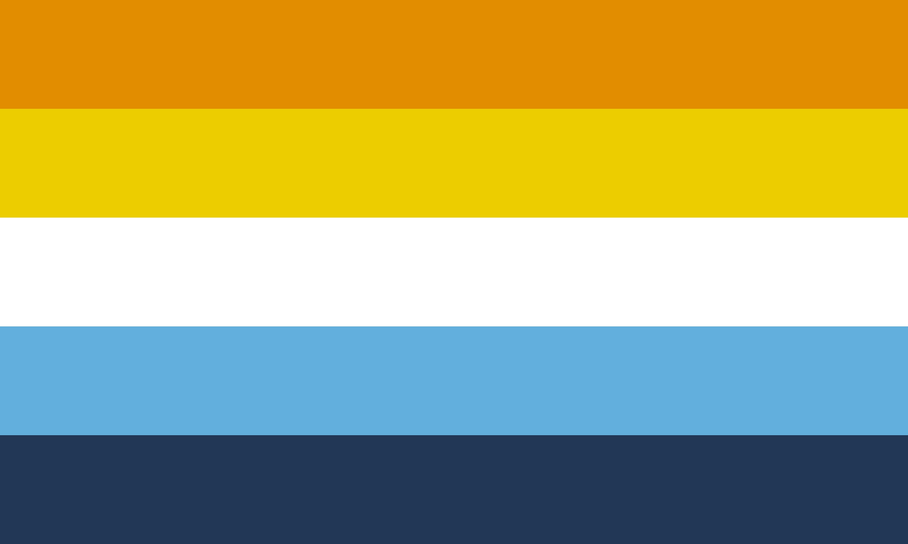
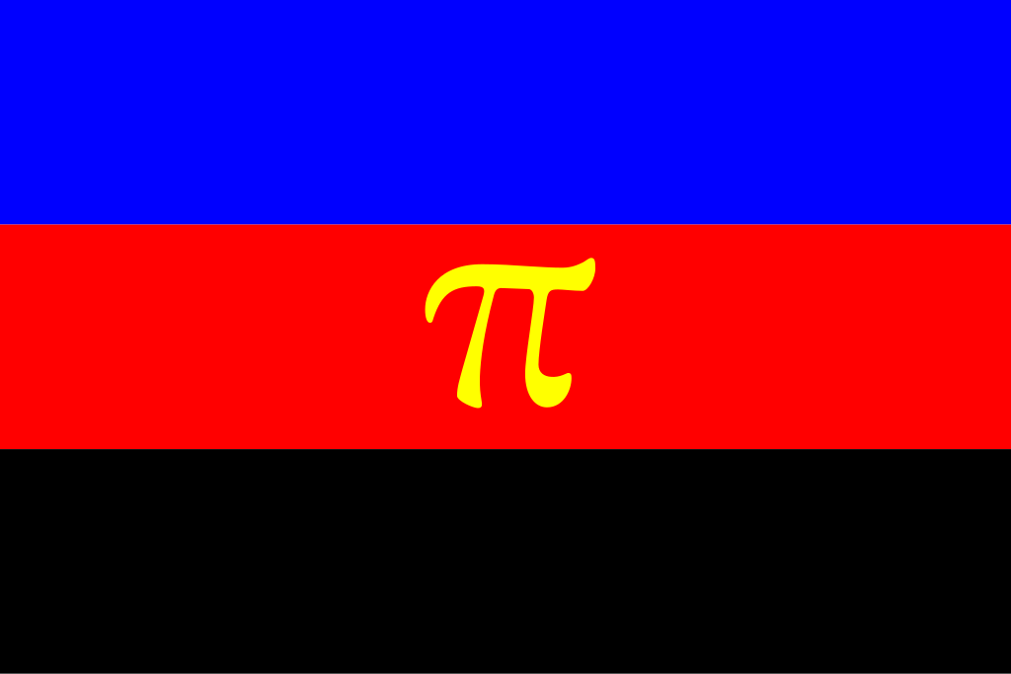
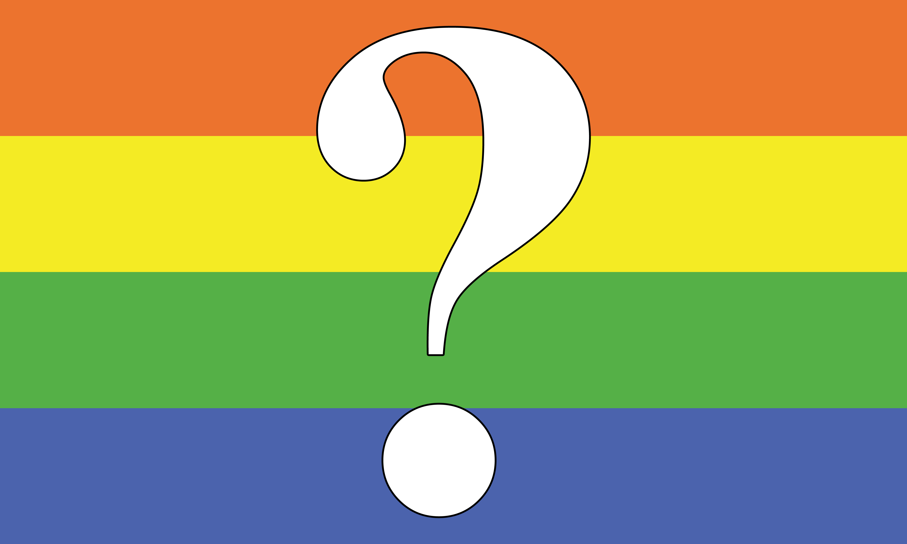
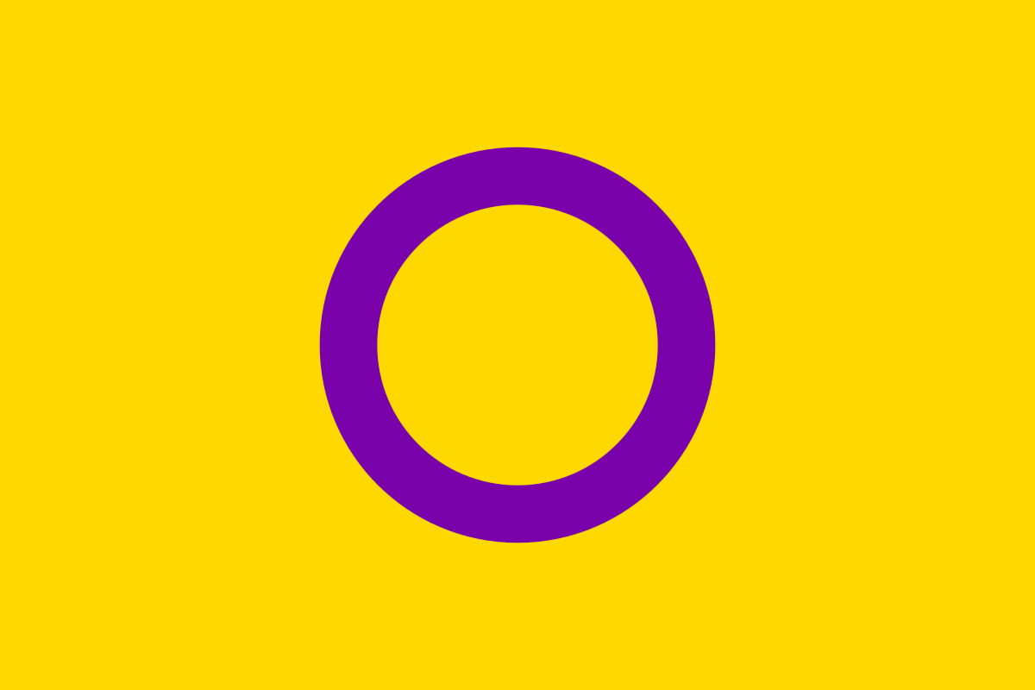
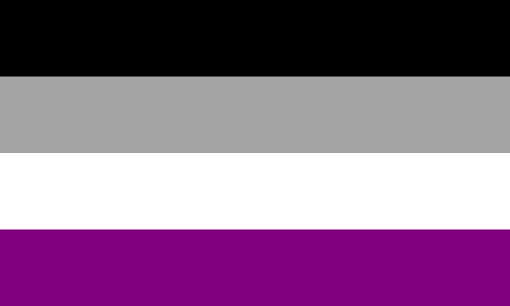
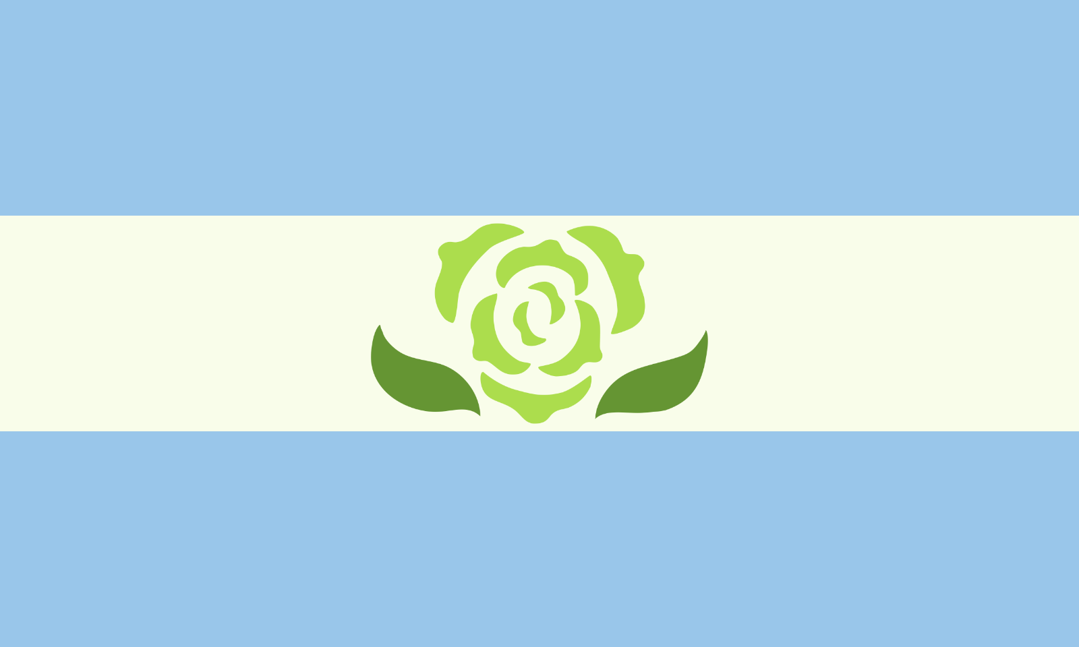
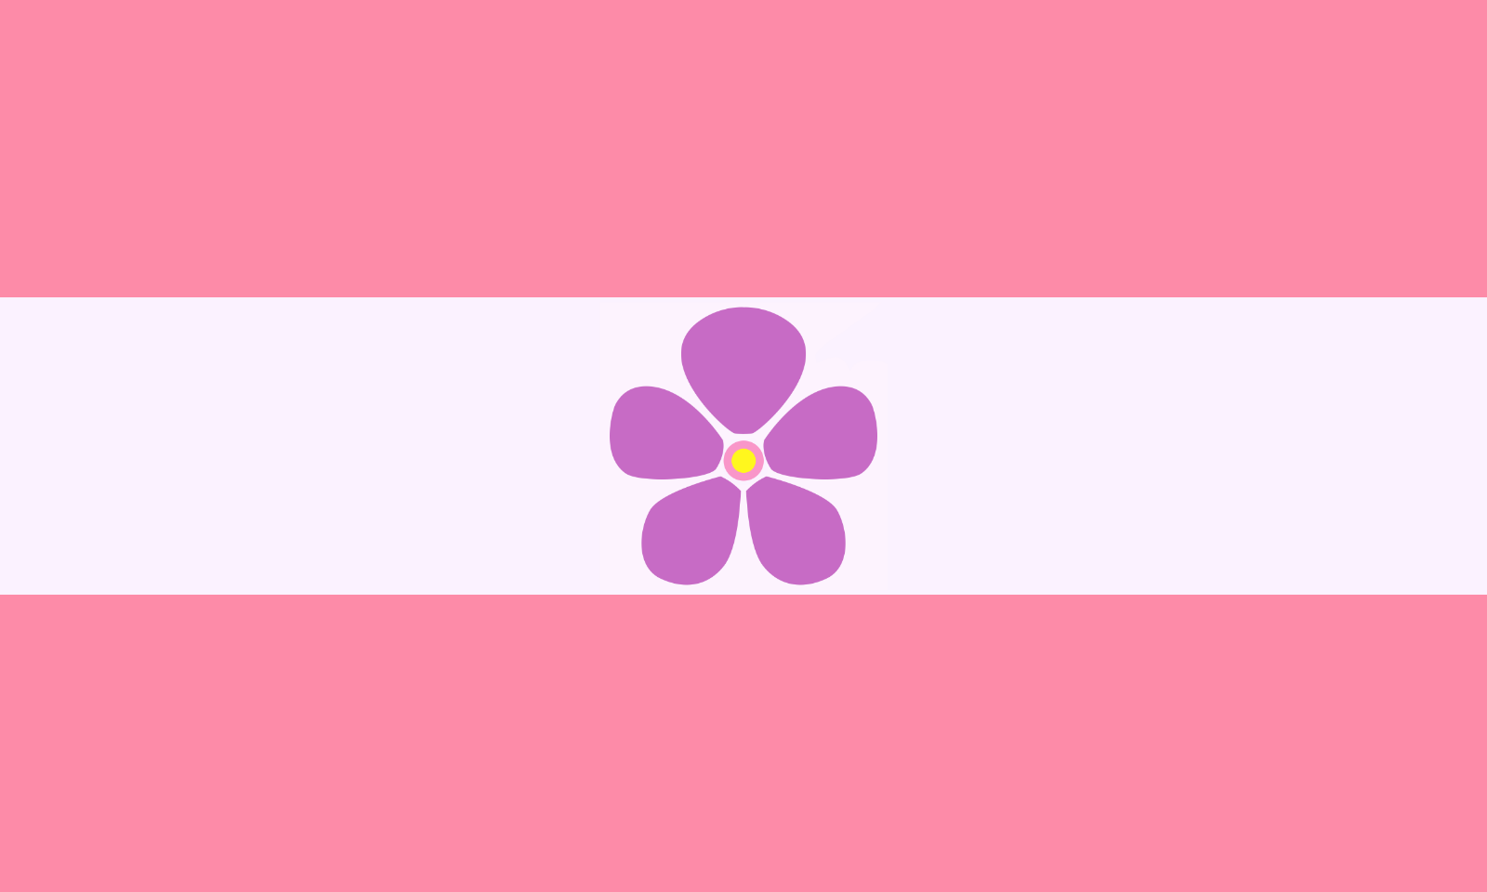
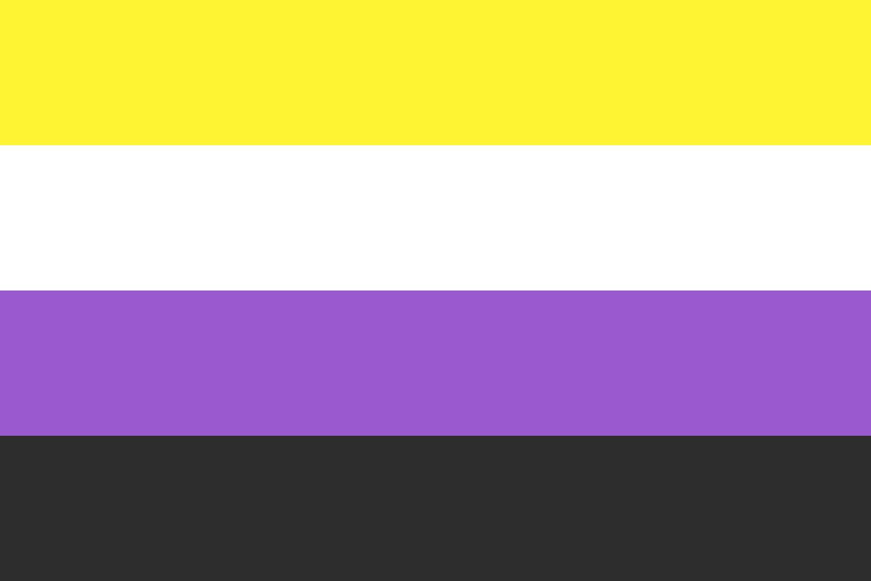
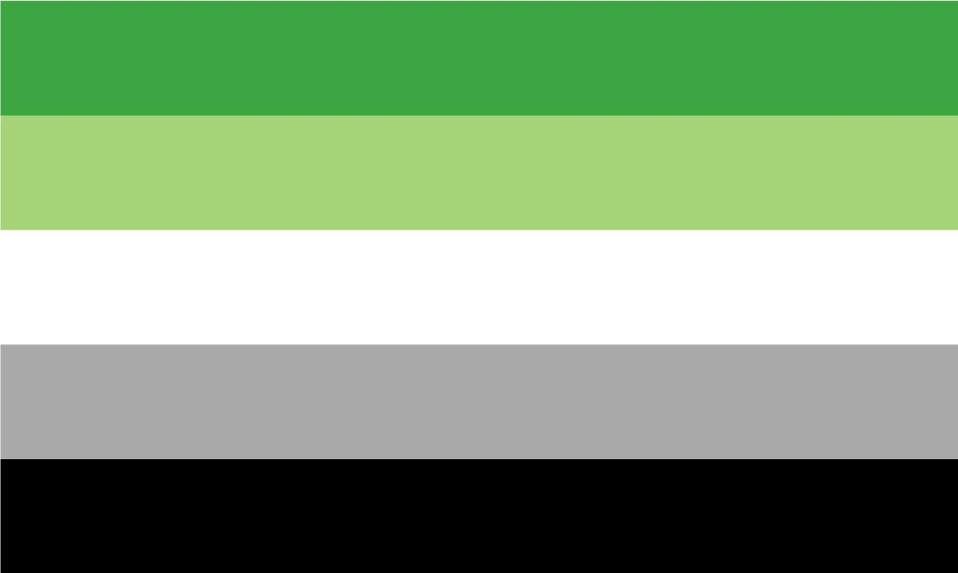
Notes:
Lesbian, gay, bisexual, trans, questioning, intersex, asexual, aromantic, sapphic, achillean, aroace, polyamorous, nonbinary

Slide 5
Lesser known Gender Identities + Microlabels
Genderqueer
Genderfluid
Genderfae/Genderfaun
Agender
Apagender
Demiboy
Demigirl
Neutrois
Androgyne
Bigender
Pangender
Two spirit
An umbrella term for gender identities that are outside the male/female gender binary
A person whose gender identity or expression is not fixed and can change over time
A gender identity which is fluid between multiple genders, but for genderfae never male nor masculine-aligned genders and genderfaun never female nor feminine-aligned genders
Does not identify with a gender identity
A person is indifferent to their gender identity and doesn't care what gender others perceive them to be
Partially identifying with male identity but not fully binary
Partially identifying with female identity but not fully binary
A non-binary gender identity that is usually associated with gender neutrality or the nullification of gender
A non-binary gender identity in which one is simultaneously a man and a woman, or in between the two
Identifying with two genders at the same time
Comfortable with multiple different gender labels
Native American people who take on the gender roles of both men and women. Two-spirit is regarded as a third gender with a connection to culture and spirituality by some and other people simply use it to refer to any Native American person who is a member of the LGBTQIA+ community.

Slide 6
Lesser known sexualities
Omnisexual
Pansexual
Abrosexual
Polysexual
Greysexual
Greyromantic
Cupiosexual
Cupioromantic
Pomosexual
Cassexual
Casromantic
attracted to all genders and sexualities
attracted to people regardless of sexuality
fluid sexuality and intensity of sexuality which changes over time
attracted to multiple genders
experiences sexual attraction occasionally, rarely or under certain conditions
experiences romantic attraction occasionally, rarely or under certain conditions
someone who desires a sexual relationship but does not experience sexual attraction
someone who wants to be in a romantic relationship but doesn't experience romantic
attraction
people who reject or do not fit into any sexual orientation label
an identity where one feels that one is indifferent to the idea of sexuality, and believes it
is not an important part of their identity
an identity where one feels that one is indifferent to the idea of romance, and believes
it is not an important part of their identity

Slide 7
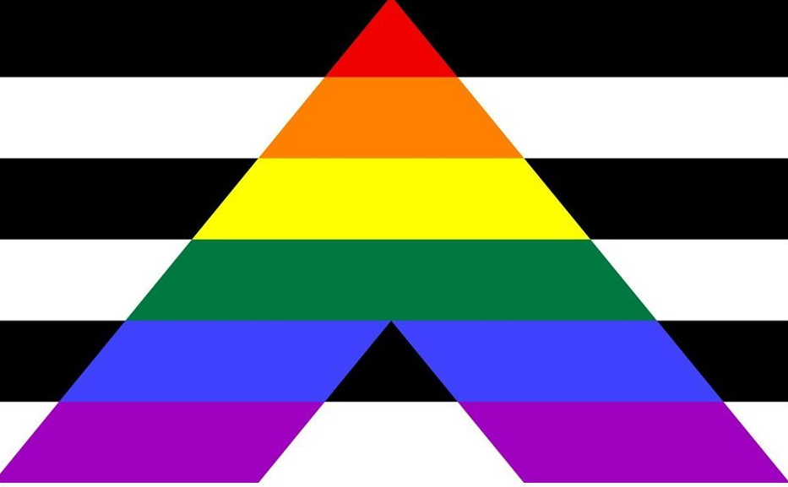
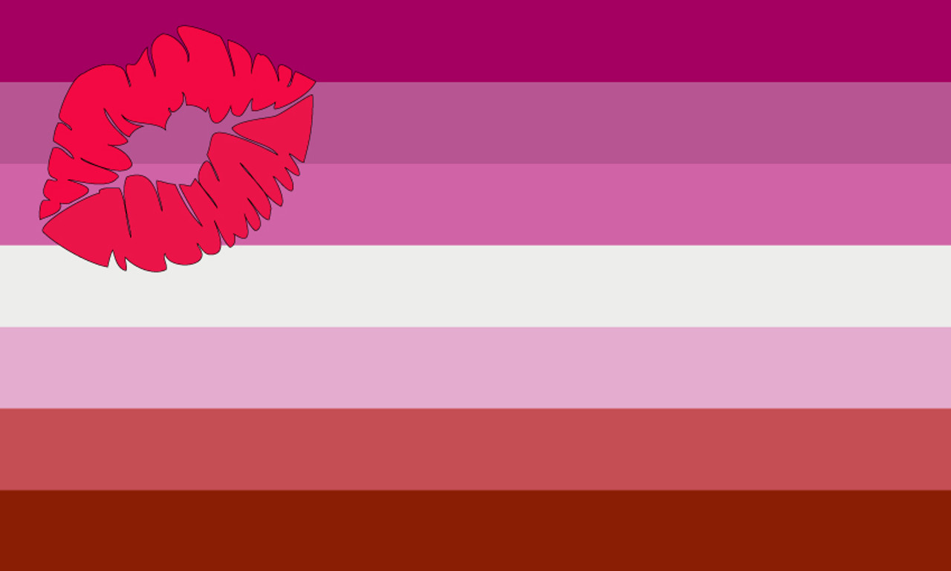
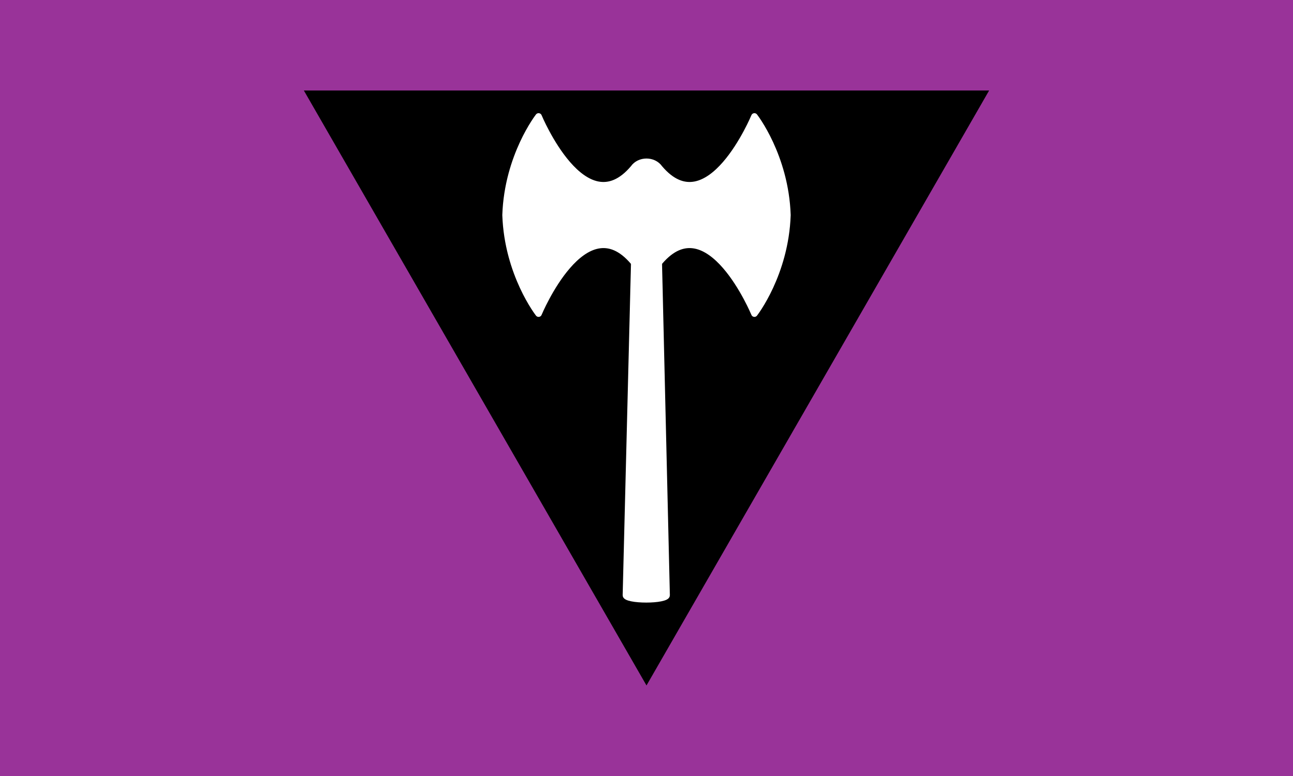
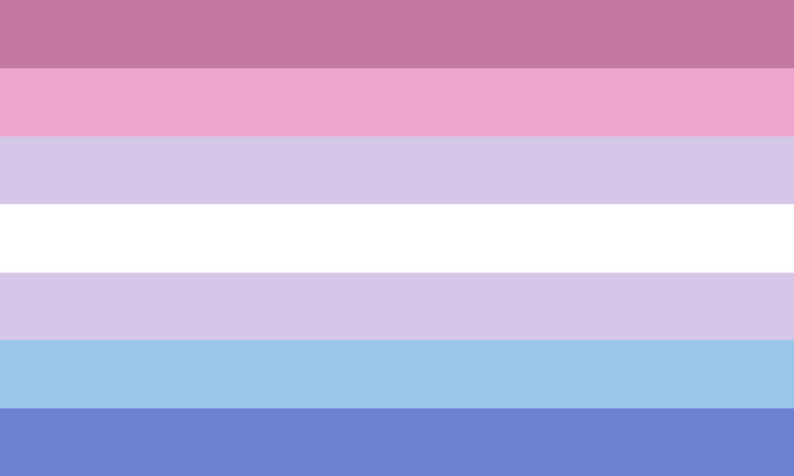
Controversial identities/flags
Straight ally
Lipstick lesbian
Labrys lesbian
TERF flag
Original bigender flag

