Slide 1
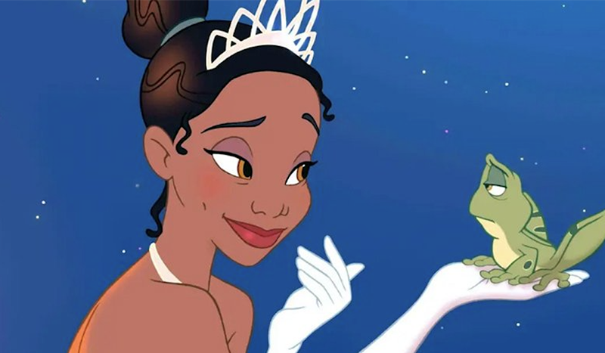
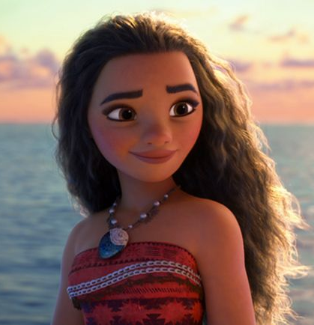
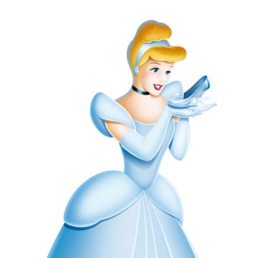
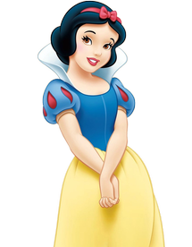
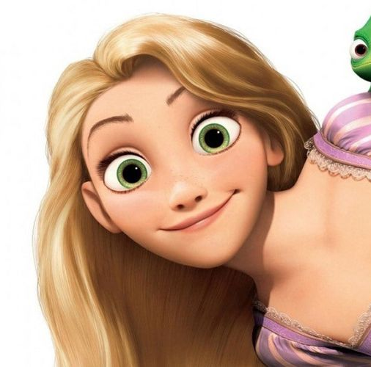
TED Talks
Stereotypes in Disney

Slide 2
Today’s Aims!
Learn about the stereotypes and archetypes in Disney films ☺
1
Learn about TED Talks and how to write and deliver a successful one ☺
2
Write and deliver our own TED Talk in groups about Disney ☺
3

Slide 3
What is your favourite Disney film and why?
Discuss with a partner!

Slide 4
What is a Stereotype?

Slide 5
What is a Stereotype?
a widely held but fixed and oversimplified image or idea of a particular type of person or thing. E.g. a gender stereotype of racial stereotype.

Slide 6
What is a Stereotype?
a widely held but fixed and oversimplified image or idea of a particular type of person or thing. E.g. a gender stereotype of racial stereotype.
Can you think of any?
Think about your favourite Disney film to help!

Slide 7
What is an Archetype?

Slide 8
What is an Archetype?
An archetype is an idea, symbol, pattern, or character-type, in a story. It’s any story element that appears again and again in stories from cultures around the world and symbolizes something universal in the human experience.
So it could be a repeated storyline, type of character or object in a story.
Can you think of any archetypes in Disney?

Slide 9
Spot the stereotype or archetype!

Slide 10
Spot the stereotype or archetype!

Slide 11
Spot the stereotype or archetype!

Slide 12
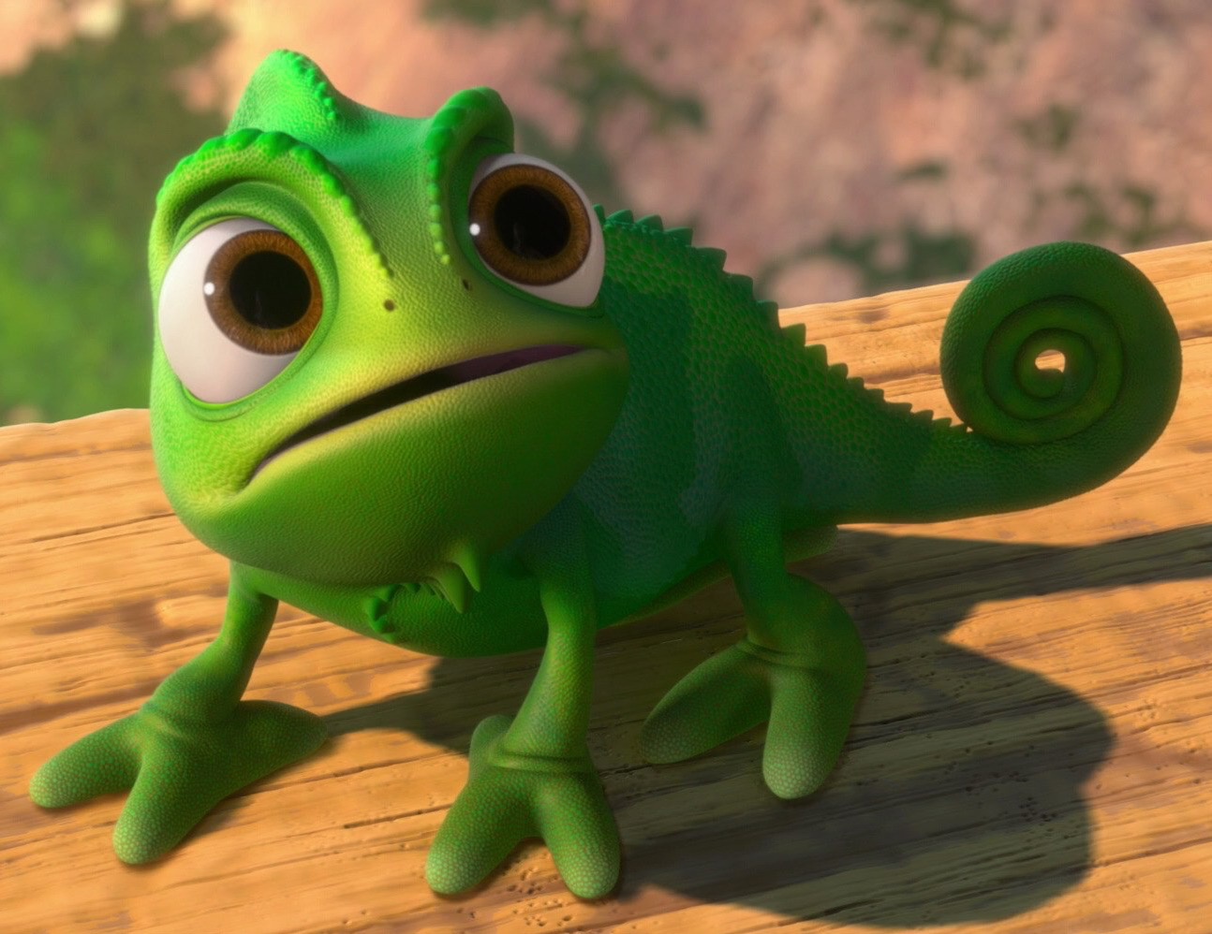
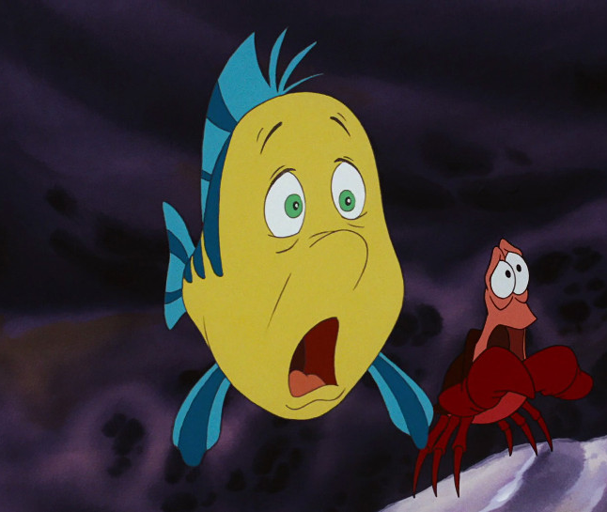
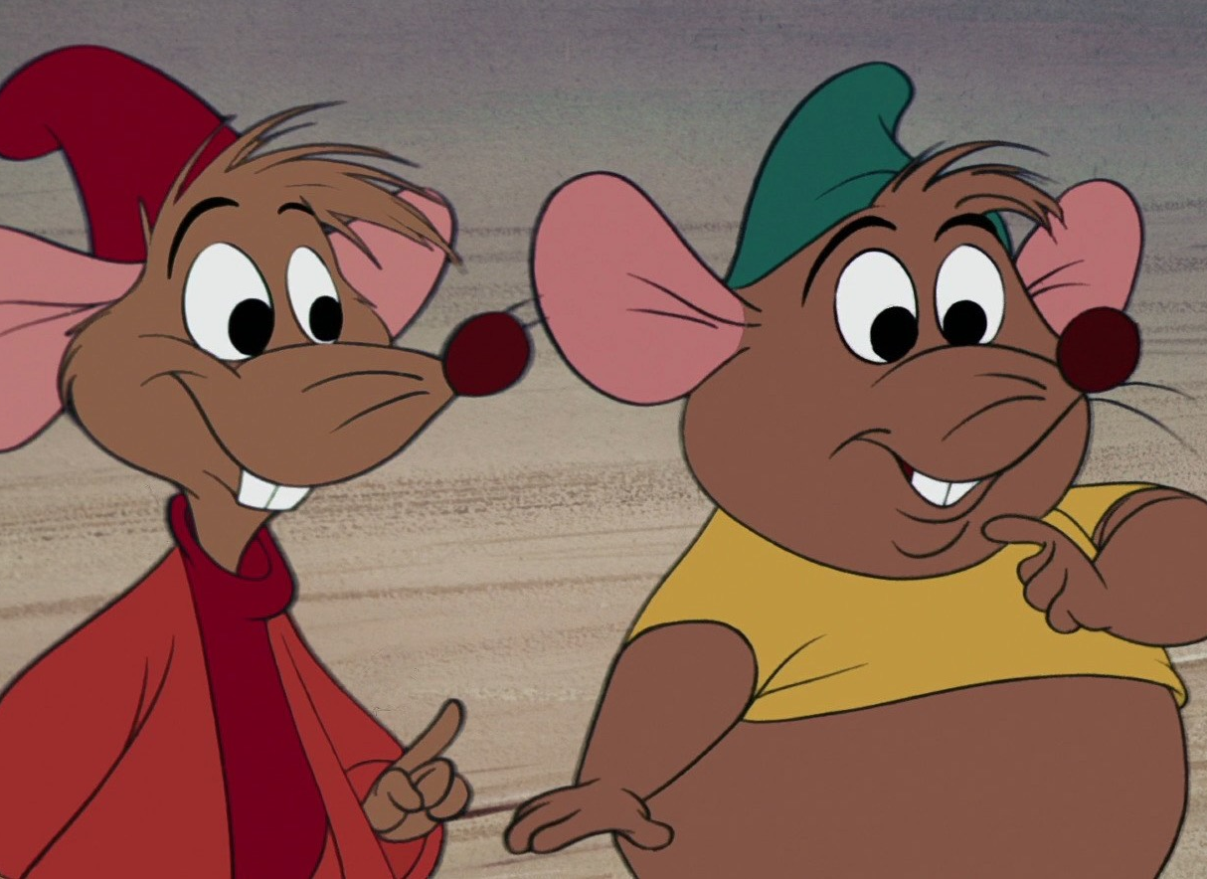
Spot the stereotype or archetype!

Slide 13
What are your thoughts on the stereotypes and archetypes of Disney?
Discuss with a partner!

Slide 14
TED Talks
What is a TED Talk??

Slide 15
TED Talks
We are about to watch a TED Talk.
As we watch, jot down why you like it – what makes it effective? What techniques does she use to captivate the audience?
You will be creating one of these so use it as inspiration!

Slide 18
TED Talk Techniques
Punchy opening
Anecdotes and stories
Teach your audience something new
Back up your ideas
Use images or props usefully
Use humour
The rule of three and/or repetition

Slide 19
Have a go…
Write 1-2 sentences about stereotypes or archetypes in Disney.
Try to use one of the TED Talk techniques in your writing.

Slide 20
Your TED Talk
In groups you will research, plan, write and perform your TED Talk.
If you need help with research, I have compiled a number of resources on firefly for us!
Your TED Talk will be about Disney.
It will be no more than 3 minutes long.
It will include some of the TED Talk techniques.
Only one person needs to perform it.
You do not need to use a powerpoint but you can if you wish.

Slide 21
Possible questions your TED Talk could answer…
Are the Disney Princess stereotypes damaging to young girls?
Are there any Disney movies that challenge gender and racial stereotypes?
Does Disney ‘whitewash’ its films?
Do we need a Prince in a modern day Disney film?

Slide 22
Method
Choose a title for your TED Talk as a group
Decide who will be the researcher, the writer and the speaker (the speaker must help with the writing too!)
Research!
Plan 2-3 three points to make in your TED Talk.
Choose some techniques to include.
Write your talk.

